Slide 1
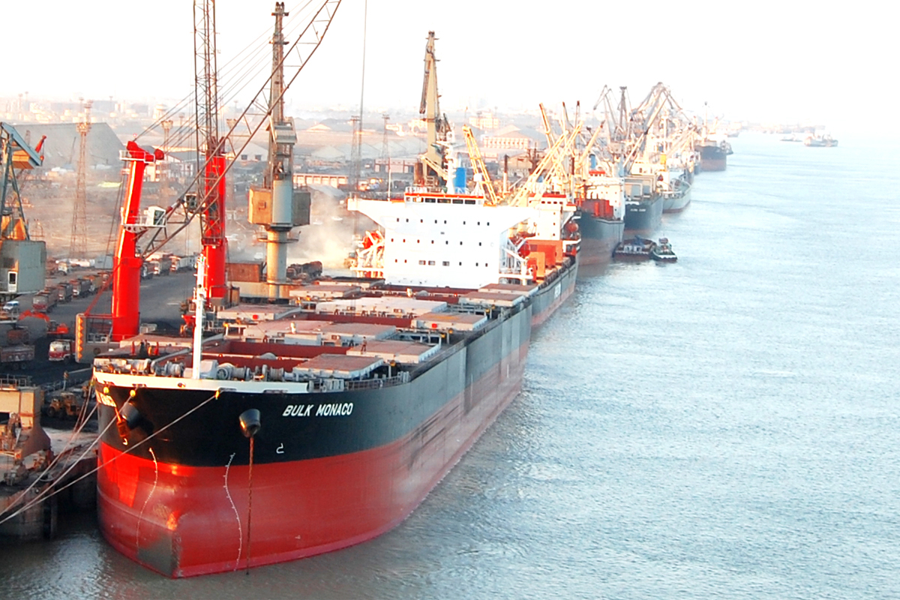

Vision Document
DEENDAYAL PORT TRUST

Slide 2
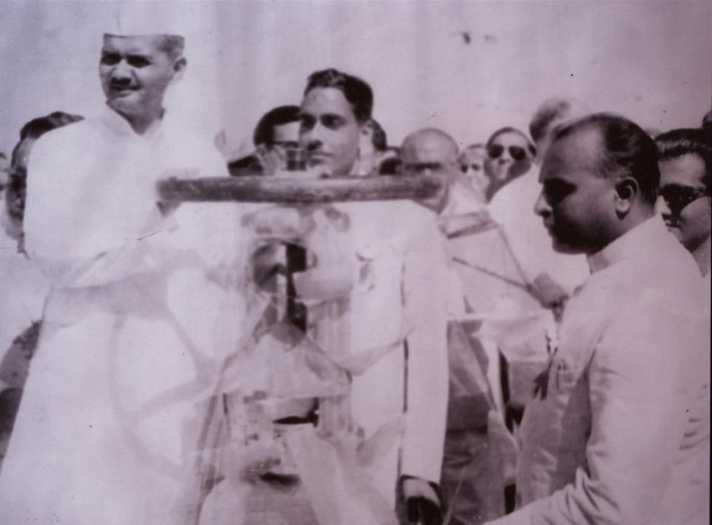
HISTORY OF DEENDAYAL PORT
Port sails past the 110 MMT mark
13th & 14th CB and IFFCO Barge Jetty commissioned
Commissioning of Container Terminal
2018
2015
12th cargo berth and Essar Oil Marine facilities commissioned
2016
2007
2013
Container handling operations commenced
1999
2006
Port sails past the 100 MMT mark
1981
Eighth cargo jetty commissioned and Port crossed 40 million mark
Kandla Port Trust was formed
1983
1978
Port sailed past the 10 million tonne milestone
Commissioning of Tuna Tekra Terminal
Four cargo jetties commenced operations
1964
1975
Offshore Oil Terminal was commissioned at Vadinar
Kandla declared as a Major Port
1957
1931
1955
Second oil jetty was commissioned
Maharao Khengarji III of Kutch built an RCC jetty
Notes:
2

Slide 3
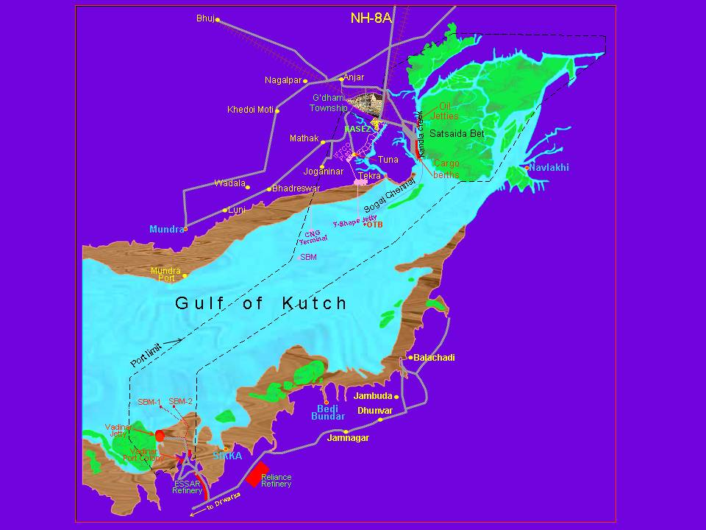
DEENDAYAL PORT LIMITS
Notes:
3

Slide 4
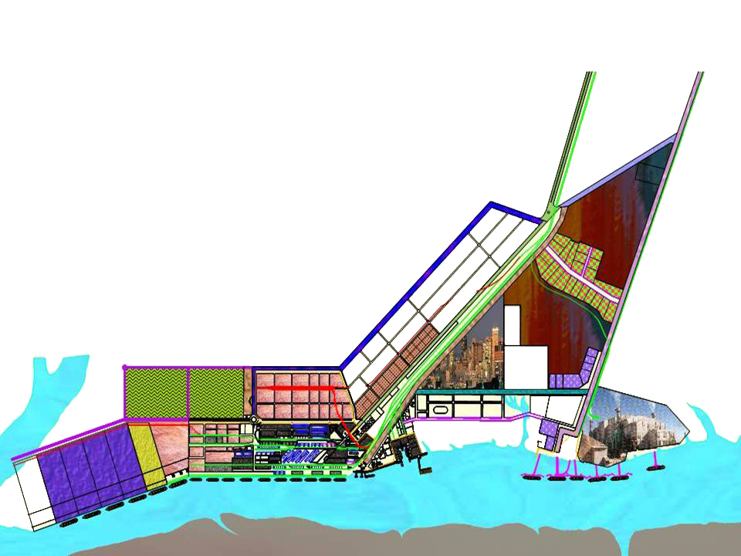
EXISTING FACILITIES AT KANDLA
Kandla
14 Dry Cargo Berths
Six Oil Jetties
Four moorings for mid-stream handling of cargoes
One Barge Jetty
Vadinar
Three SBMs and Two OJs
1 to 10 Dry Cargo berth (1987m)
11 CB
Oil Jetty Complex
12CB
K A N D L A C R E E K
S A T H S A I D A B E T
Notes:
4

Slide 5
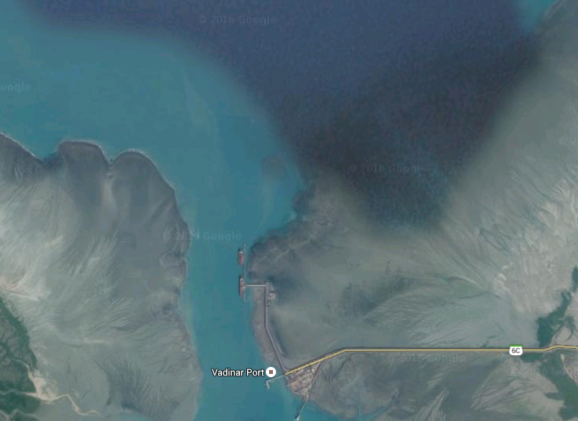
VADINAR
EXISTING FACILITIES AT VADINAR
Existing ESSR SBM
Existing 2nd SBM
Existing 1st SBM
Proposed ESSAR SBM
Proposed ESSAR Product Jetties
ESSAR Product Jetty
VADINAR
Three SBMs
Two OJs
Existing Berthing Jetty

Slide 6
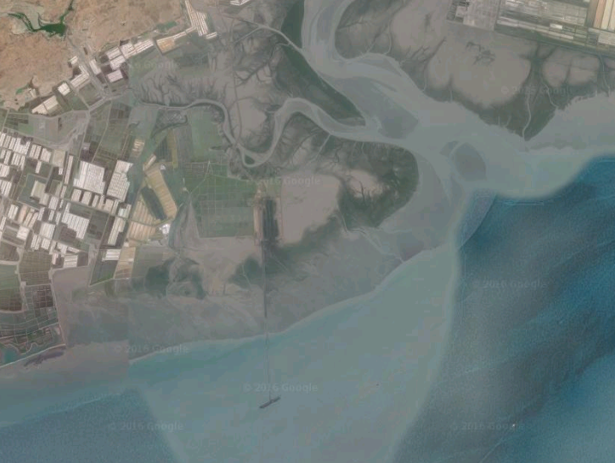
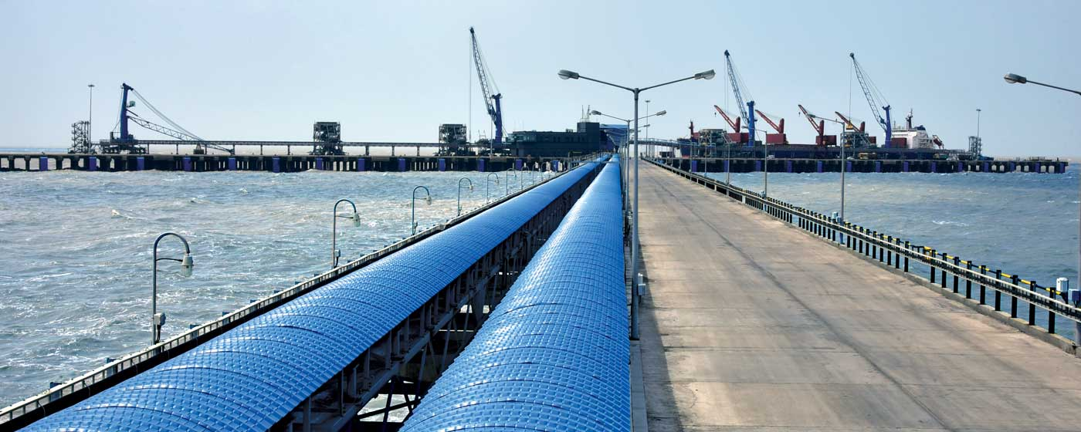
EXISTING FACILITIES AT TUNA-TEKRA
Tuna Barge Jetty
Adani Dry Bulk Terminals
Notes:
6

Slide 7
VISION, OVERALL PERSPECTIVE AND BROAD ROADMAP
1
CAPACITY AUGMENTATION
2
CARGO EMPHASIS & FOCUS
4
COASTAL CARGO FOCUS
5
REVENUE & PROFITABILITY
6
CONNECTIVITY IMPROVEMENT
7
IT INITIATIVES
8
PORT-LED INDUSTRIALIZATION
3
PERFORMANCE PARAMETERS
9
HR DEVELOPMENT
10
TRANSPARENCY PLAN
11
GREEN INITIATIVES
12
LAND DEVELOPMENT

Slide 8
1. CAPACITY AUGMENTATION
VISION:- To increase the Cargo Handling Capacity of the Port from existing 246 MMTPA (2018-19) to 298 MMTPA (2021-22). Number of Berths from 29 + 3SBMs to 39 + 4SBMs
ROADMAP:-
ADDITIONAL CAPACITY & MODERNIZATION OF LIQUID CARGO
LIQUID CARGO CAPACITY addition of 16.00 MMTPA at Kandla (Dec ‘20) and 24.50 MMTPA at Vadinar (Dec ’21)
GENERAL CARGO CAPACITY addition of 9.0 MMTPA at Kandla (May ’19).
BUNKERING COMPLEX addition of 3.39 MMTPA at Kandla (Sept ‘20).
RATIONALIZATION OF PIPELINES

Slide 9
2. CARGO EMPHASIS AND FOCUS
VISION: To increase Cargo handling from 110.10 MMT (2017-18) TO 131.27 MMT (2021-22)
Cargo description | Cargo handled (MMT) in 2014-15 | Cargo handled (MMT) in 2017-18 | Cargo handling (MMT) in 2021-22
POL | 55.59 | 62.20 | 65.03
Non-POL | 7.06 | 9.94 | 14.00
Fertilizer | 5.85 | 3.56 | 6.00
Coal | 9.97 | 13.79 | 16.74
Timber | 2.85 | 2.80 | 3.51
Container | - | 1.84 | 5.50
Salt | 2.71 | 7.74 | 9.21
LPG | - | 1.20 | 2.50
Total | 92.50 | 110.10 | 131.27
ROADMAP:-
CARGO PROFILE(EXIM) OF LAST TWO YEARS

Slide 10
2. CARGO WISE ROADMAP
Product | Description
POL | One SBM and 2 Product Jetties by M/s Essar at Vadinar
Non-POL | Rationalization of Pipelines
Fertilizer | Fertilizer Bagging Plant at NG 34 & Mechanization of Fertilizer Handling at Berth No. 14
Coal | Mechanized coal handling, 2 Nos. of MHC inducted and expansion of Coal Stacking area (along with coal pollution prevention through re-organization of Cargo stack yards, Water Sprinkling system & Wind screen)
Timber | Expansion of Timber Stacking Yard.
Container | Increasing LOA of vessels visiting KICT & rebate extended to Foreign (50 % of VRC) & Coastal vessels (55 % of VRC) till March 2019.
Salt | Providing contamination free berths, stacking space, accommodation of more vessels with higher productivity in the Berthing policy.
LPG (IOC/HPCL) | Increased Handling of LPG at OJ1 and up-coming OJ7.
. Handling Bitumen, Vopak Chemical Projects , Project Cargo.
LPG Jetty (OJ7) being constructed (for IOCL)
Setting up of food park
Allotment of tank farms for Non-POL cargoes.
Around 1 MMT of Crude oil (high viscosity grade) will be handled at product jetties at Vadinar.

Slide 11
3. PERFORMANCE PARAMETERS
VISION:- To improve TRT from 60 to 55 Hrs., Average Output per Berth Day from 18531 MT to 23000 MT. Cost per ton from Rs. 61.58 to Rs. 56.
Turnaround Time (Hrs)
Average Output per Berth Day (Tonnes)
Y-o-Y Improvement
Y-o-Y Growth
5.1%
3.2%
0.4%
0.4%
1.7%
10.9%
ROADMAP:-
Induction of 2 Nos. of HMC and Operationalization of Fertilizer Bagging Plant will increase productivity and faster evacuation of Cargo will help in reducing vessel turn around time.
Operationalization of Berth No. 14 & 16 will bring down pre-berthing detention of Vessels.
Rationalization of Pipelines will improve productivity thereby reducing pre-berthing detention.
Sensors, TOS & ERP System.
RFD Targets 2018-19

Slide 12
4. COASTAL CARGO FOCUS
VISION :
To increase Coastal Cargo share from 11.3 MMT (2017-18) to 15 MMT (2021-22)
Total
In MMTPA
9.2
8.6
7.4
11.3
11.5
PRESENT COASTAL CARGO SHARE
Coastal traffic increased by nearly 23% in last 4 years from 9.2 to 11.3 MMT.
POL is the major coastal shipping commodity at DPT contributing nearly 87% of the overall coastal traffic in 2017-18.
DPT handled 2.148 MMT of coastal traffic in FY 2018-19 (upto May’18) as against 2.004 MMT in FY 2017-18 (upto May) with an increase of more than 7%.
During FY 2018-19 (upto May), the port handled 1.79 MMT POL, 0.01 MMT of Coal and 0.35 MMT of Other cargoes.

Slide 13
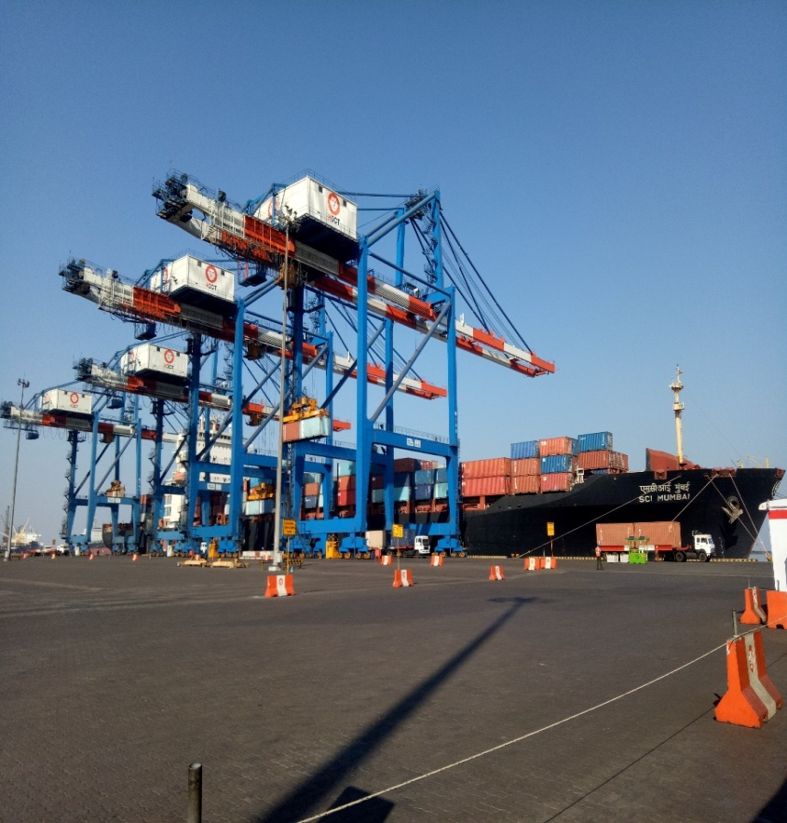
4. COASTAL CARGO FOCUS (Contd.)
ROADMAP:-
Potential cargo: Salt, Silica sand, Iron Ore, Coal, Fertilizers, Wheat, Containers (for Cotton, Clinker, Fertilizers, Tiles, Bagged salt etc.), Automobiles (through Ro-Ro vessels), Steel Pipes (through Ro-Ro by wheel).
Coastal container vessels given a discount of 55% in all vessel related charges upto March 2019.
Coastal container projected to increase to the tune of 1.20 lakhs in 2018-19 TEUs against 19188 TEUs during the year 2017-18.
The cabotage relaxation will enhance DPT feeder capacity to support movement of EXIM containers to Cochin Port if it becomes hub port for transhipment.

Slide 14
5. REVENUE & PROFITABILITY
VISION :-
Operating Income to increase from Rs. 1475 Crore in 2017-18 to Rs. 2300 Crore in 2021-22.
Operating surplus will double from 2017-18 to 2021-22 and net surplus will increase from Rs. 546 Cr. in 2017-18 to Rs. 1596 Cr. in 2021-22
DPT has made arrears contribution of Rs. 325 Cr. towards pension liability during 2017-18 and having self sufficient retirement funds and only yearly contribution is being made.
ROADMAP:-
# | Description | Cumulative Additional Revenue (Upto 2021-22)
1 | Revenue from SIPC | Rs. 114 Cr.
2 | SOR Revision | Rs. 780 Cr.
3 | Two Mobile Harbour Cranes | Rs. 70 Cr.
4 | Leasing of Land | Rs. 220 Cr.
5 | Wind Power Project | Rs. 73 Cr.
6 | Revenue from ROB | Rs. 17 Cr.
7 | Revenue from Ship Bunkering | Rs. 63 Cr.
8 | Revenue from Bagging Plant | Rs. 3 Cr.
9 | Essar-VLTL | Rs. 18 Cr.
Kandla
Financials for Last 5 Years
Vadinar
Kandla & Vadinar (Consolidated)
Detailed Parameters for 2017-18

Slide 15
6. CONNECTIVITY
VISION :-
Rail Connectivity to the Berth Nos. 13, 14, 15, 16 for quick evacuation of cargo directly from the Berth
Road Connectivity - ROB at Kutch Salt Junction - Kandla
Parking Plot at Liquid Storage Tank farm area.
ROADMAP:-
# | Rail Projects | Cost (Rs. Cr) | Length (Km) | Implementing Agency | Status | Completion Target
1 | Rail connectivity to berth No. 13, 14, 15 & 16 from take-off point to west end of berth at Deendayal Port. | 109 | 10 | IPRCL | Work in progress | Sept-19
2 | Development of Railway Network north of Oil Jetty no. 7 and near Jafarwadi | 150 | 15 | IPRCL | Preparation of DPR is in progress | Feb-21
# | Road Projects | Cost (Rs. Cr) | Length (Km) | Implementing Agency | Status | Completion Target
1. | RoB at Kutch Salt Junction - Kandla | 232.62 | 15 | IPRCL | Under Implementation (EC awaited) | March-21
# | Parking Plot at Liquid Storage Tank | Cost (Rs. Cr) | No | Implementing Agency | Status | Completion Target
1. | Parking Plot at Liquid Storage Tank Farm area | 10.27 Cr. | 500 Trucks | M/s. Bhimji Velji Sorathiya | Work in progress | Sep-18

Slide 16
7. IT INITIATIVES
VISION:- Complete Computerization by 2021.
ROADMAP:-
# | Initiatives | Timelines
1 | Access Control System | March 2019
2 | RFID | March 2019
3 | ERP | July 2019
4 | E-Office and E-Platform | Dec-18
5 | Port Community System (PCS) 1 Plus | Nov-18
6 | Port Community System (PCS) 2.0 | Consultant Appointed
7 | IT Security | Aug-18

Slide 17
8. PORT-LED INDUSTRIALIZATION
Smart Industrial Port City – Kandla
VISION :-
Development of Port Led Industries & allied port activities
Smartly Enabled to be responsive to Infrastructure Development & its Management
Be self sustainable – Green Energy, Water Recycling, Recycled Waste etc.
Offer good Quality of Life.
ROADMAP:-
Location | Usage | Area (Acres) | Expenditure by Port (Rs. Cr) | Investment Expected (Rs. Cr) | Employment Potential (Construction) | Employment Potential (Operations) | Status Timelines
Kandla | Industrial Park with Logistics Facilities | 845 | 676 | 6,000 | 500 | 40,000 (Direct & Indirect) | Expected date of all allotment should be completed by 2020.
Smart Township | Residential & Mixed use | 580 | 471 | 4,000 | 250 | 10,000 (Direct & Indirect) | Expected date of all allotment should be completed by 2022.
Total |  | 1,425 | 1,147 | 10,000 | 750 | 50,000
STATUS OF SIPC

Slide 18
9. HUMAN RESOURCE DEVELOPMENT
VISION :
Maximum individual development of Port employees and integrating their aspirations with organizational goals.
HR Profile :-
4,305 Pensioners / family pensioners
1097 (42%) of employees will retire by 2025 (Retirement Profile).
Limited induction in technical & essential categories and professional functionaries on contractual basis
Operating revenue per employee Rs. 0.57 cr.
Total Strength :- 2586
Class I :- 81
Class II :- 59
Class III :- 1037
Class IV :- 688
CHD & Shore Workers :- 721
ROADMAP:-
ROADMAP | Timeline
Manpower Planning through Scientific Work-study with emphasis on core & non-core activity. | 9 Months
Recruitment of Professionals & Skilled workforce in every department. | Ongoing Process
3-Tier training programme for their development and enhanced productivity. | Ongoing Process
Honouring performing employees and formulating reward schemes. | Ongoing Process
Proper career planning for Port employees | 12 Months

Slide 19

10. TRANSPARENCY PLAN
ROADMAP:-
Transparency by placing all relevant information on website | Vigilance Action
Transparent System aiming at Minimum Discretion | Changing Minds Programme
Independent External Scrutiny | Transparent Policies in HR
Stakeholders Interaction | Transparent Policy for Land Allotment & Management
Accessibility of Management to Public | Employees’ Grievances Redressal System
Transparency Acts/ Policies | Incentivization of Integrity
Transparency in Receipts & Payments | Capacity Building
Grievance/ Complaint Redressal & feedback Mechanism | Monitoring by the Senior Management
Minimization of Discretion through Computerization | Evolving Organization
VISION:- Addressing corruption through an electronic public interface, independent checks & balances and inculcation of positive mindset.
TIMELINE:-
Adopted & under implementation. To be fully implemented within a period of 3 months.

Slide 20
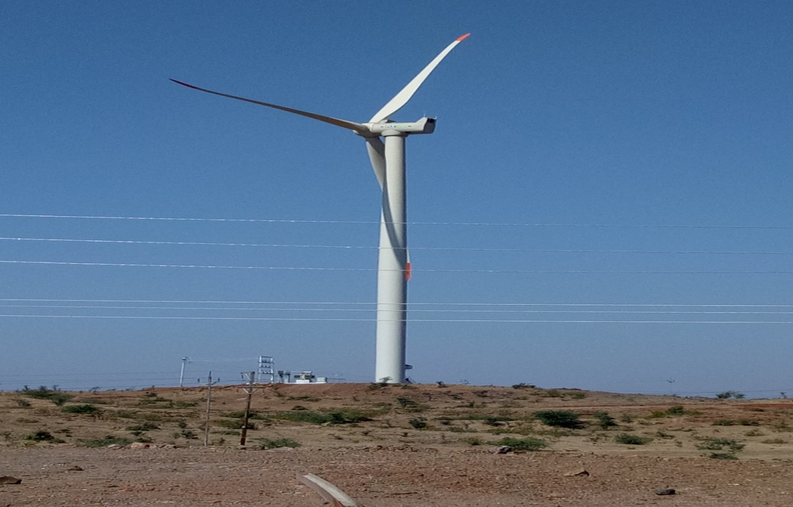
11. GREEN INITIATIVES
VISION: Developing Green Energy Source to minimize environmental impact.
ROADMAP:-
Wind Power projects:
  (i)6 MW Wind Power Project installed & Commissioned on 31-3-2017
  (ii) 14 MW wind Power Project is under installation.
  (iii) Combined Production of 5.4 crore units per year.
  (iv) Reduction of 43,000 Tonne of CO₂ emissions.
Renewable Energy Park - Wind Power Project
LED Lighting
  Replaced 2500 conventional lights with LED Lights.
  Agreement signed with Energy Efficiency Services Ltd. (EESL) on 6th June, 2018 for replacement of 4600 conventional lights with LED through ESCO Model (September 2018).
  Agreement with EESL for replacement of 1000 number of conventional lights with LED lights in Port Colony (timeline Oct, 2018).
(C) Roof top Solar Power Plant
  Installation of 175 KWp Solar Roof Top Plant at Administrative Office Building (timeline December 2018).
Installation of Water Sprinkling System to reduce the Coal dust in Operational area to comply with the GPCB/MoEF norms to prevent Dust pollution (timeline).
(E) PTC India Ltd. is engaged as service operator for managing the electricity distribution business, advisory support, energy auditing and illumination survey, supervision & capex planning at Deendayal Port for a period of 3 years.
Comprehensive Pollution prevention measure for Coal Handling (Wind Screen, allocation of separate stackyard, sprinklers, Sweeping Machine, Mechanization)

Slide 21
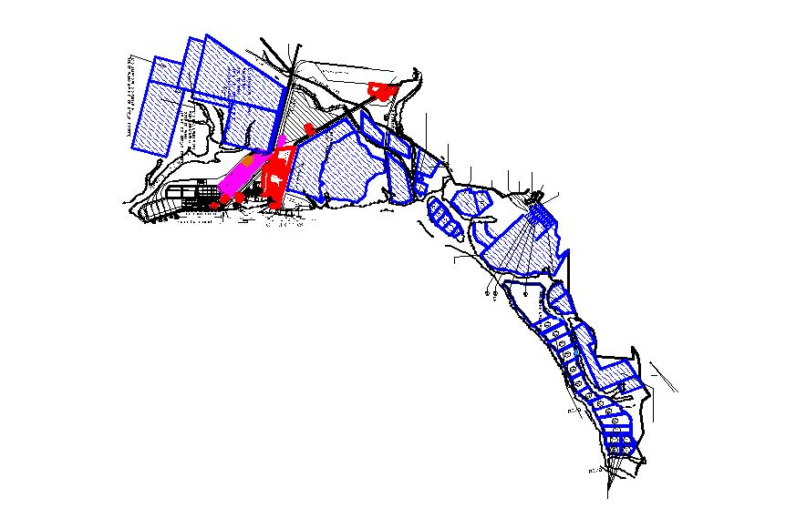
12. LAND DEVELOPMENT
VISION:- Ensure optimum utilization of 46 Plots of vacant salt land, 4+7 Tank Farm Plots and 7 Other Port related activity plots for various purposes generating additional revenue of Rs.55.21 crores per year (for 30 years – Rs.1656.30 crores)
ROADMAP:-
ESTATE MANAGEMENT
LOCATION | No. of Plots | Timeline
SALT PLOTS | 46 | March-2019
LIQUID TANK FARM PLOTS | 4+7 | March-2019
PORT RELATED ACTIVITY PLOTS | 7 | March-2019
LAND DEVELOPMENT FOR SMART TOWNSHIP
Development of Smart Township | Expected date of allotment of all plots – Dec ‘22.
PARKING PLOT AT LIQUID STORAGE TANK

Slide 22
PORT’S MAJOR DEVELOPMENT PROJECTS
S No | Name of the Project | Salient Features | Status
1. | Construction of 14th Berth for Multipurpose Cargo (Other than Liquid/Container), Kandla | Cost : Rs 138.28 Cr. 4.5 MMTPA | To be completed by May 2019(65 % complete)
2. | Construction of 16th Berth for Multipurpose Cargo (Other than Liquid/Container), Kandla | Cost : Rs 131.5 Cr. 4.5 MMTPA | To be completed by May 2019(60 % complete)
3. | Development of Smart Industrial Port City (SIPC) at Kandla – Gandhidham – Adipur Complex | 1.Residential & commercial: 580Acr 2.Industrial Area: 800 acres | E- auction done for 52 acres of land in location 2 (Emami’s bid the highest)
4. | The providing rail connectivity to berth No. 13,14,15 & 16 from take off point to Western end of berth | Cost: Rs. 109.03 Cr. | To be completed by Sep 2019 ( Execution: IPRCL)
5. | Construction of Oil Jetty no 7 through internal resources. | Cost: Rs 42.40 Cr 2 MMTPA | CRZ and Environmental Clearance are awaited due to the NGT Order dated 22.11.2017
6. | Construction of Oil Jetty no 8 through internal resources. | Cost: Rs.150 Cr. 3.5 MMTPA | Award of work subject to Environmental Clearance.
7. | Replacement & Revamping of Pipeline Network at Oil Jetty area, Kandla-(Rationalization of Pipelines) | Cost: Rs170.42 Cr. Increased capacity of 2MMT | Environment Clearance work has been also awarded to MECON Ltd. dated 23.02.2018, to be completed in 2 years after EC

Slide 23
PORT’S MAJOR DEVELOPMENT PROJECTS
S No | Name of the Project | Salient Features | Status
8 | Construction of Dr. Ambedkar Convention Centre. | Cost: Rs.14.54 cr 500 Pax (Inside) 500 Pax (Outside) | Work Order to the L-1 bidder viz., M/s. Maruti Construction Co.Ahmedabad kept in abeyance
9 | Development of 13th multipurpose(other than container/liquid) cargo berth on BOT basis | Multipurpose berth. Total claim by DPT: 2440 crores. Debt due as per lenders:183 Cr | Concession agreement terminated on 29.09.2017, Possession under DPT, Operations started on 5.11.2017, Arbitration proceedings on
10 | Development of 15th multipurpose(other than container/liquid) cargo berth on BOT basis | Multipurpose berth Total Claim by DPT:2466 Cr Debt Due: 92 Cr | Concession agreement terminated on 29.09.2017, Possession yet to be taken Due Debt of 92 Cr deposited by DPT in an escrow account
11 | Developing Dry Bulk Terminal Off Tekra near Tuna, outside Kandla Creek on BOT Basis. | Royalty Share: 25.09% of gross revenue, Capacity: 14.112 MT | Commercial operation started in 2015. 2016-17, 17-18 capacity utilization close to 30 %, Writ petition filed by AKBTL( Adani group)
12. | Mechanized handling facility for fertilize at Berth no. 14 | Cost: Rs.347.59 cr. Capacity:1200 bags per hour, 4.50 MMTPA | Likely completion: Oct.2020
13. | 14 MW Wind Power Project | Cost:Rs.142.32 crores. 7 no. wind turbines installed of 2.1 MW each.Annual Energy Production – 3.9 crore units. | All 7 WTGs have been erected. Expected to be commissioned by September, 2018.

Slide 24
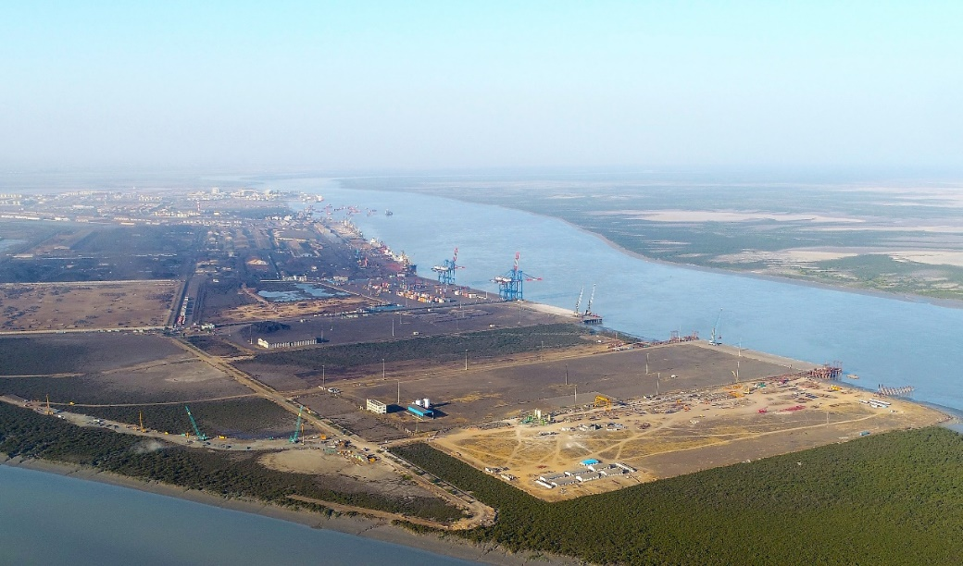
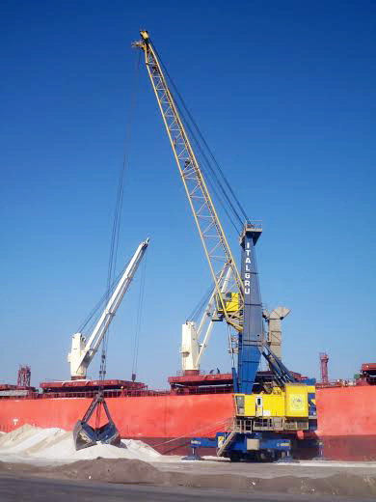
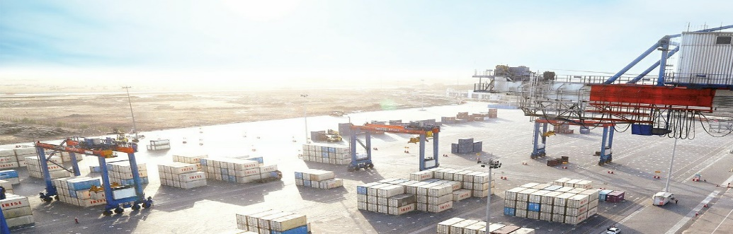
PORT’S MAJOR DEVELOPMENT PROJECTS

Slide 25
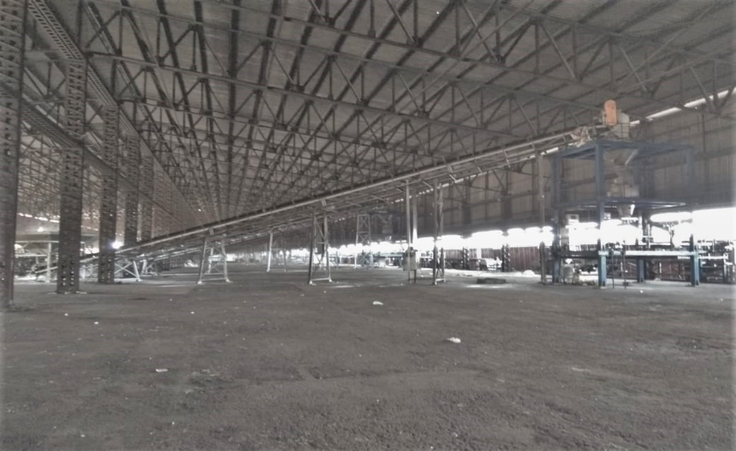
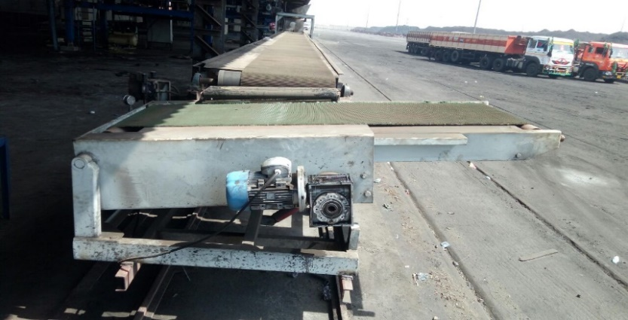
MECHANIZED BAGGING & WAGON LOADING FACILITY FOR FERTILIZER
AT NG 34, KANDLA
Bagging & stitching units
Wagon loaders
DEENDAYAL PORT TRUST

Slide 26
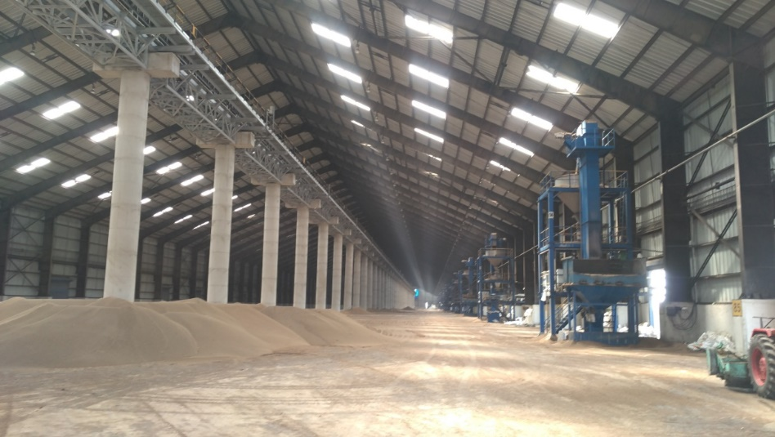
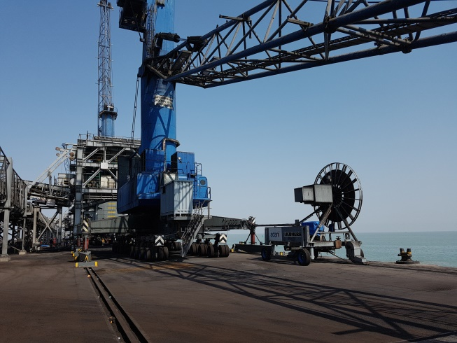
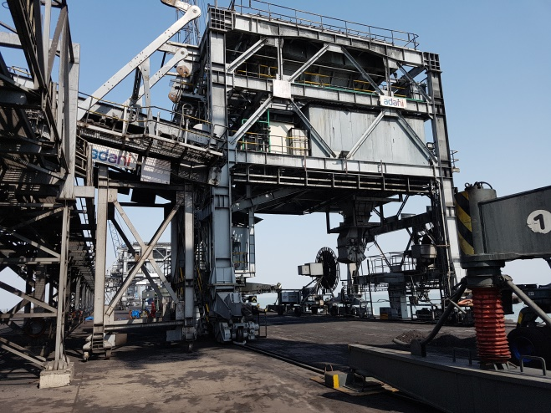
            MECHANIZED HANDLING FACILITY FOR FERTILIZER AT BERTH NO. 14
Storage shed
Mobile hopper
DEENDAYAL PORT TRUST

Slide 27
RECOGNITION & AWARDS
Received Major Port of the year award at Maritime And Logistics Awards (MALA) - 2017 held on 15/9/2017 in Mumbai.
Received Port of the year award at Gujarat Star Awards - 2017 held on 25/11/2017 in Gandhidham.
Received Public Port of the year award at Samudra Manthan Awards 2017 held on 15/12/2017 in Mumbai.
Received Port of the year (Non-Containerised Cargo) award at Gujarat Junction Cargo & Logistics Awards 2018 held on 17/03/2018 in Gandhidham.
“ET NOW Making of Developed India Award for Excellence in Green & Waste” – received on 17/02/2018 for the Best Organization towards GREEN INITIATIVE GREEN CAMPAIGN.
“National Awards for Excellence in Green & Waste” – National CSR leadership congress & Awards received on 20/09/2017 for the Best Green Organization of the Year.
DEENDAYAL PORT TRUST

Slide 28
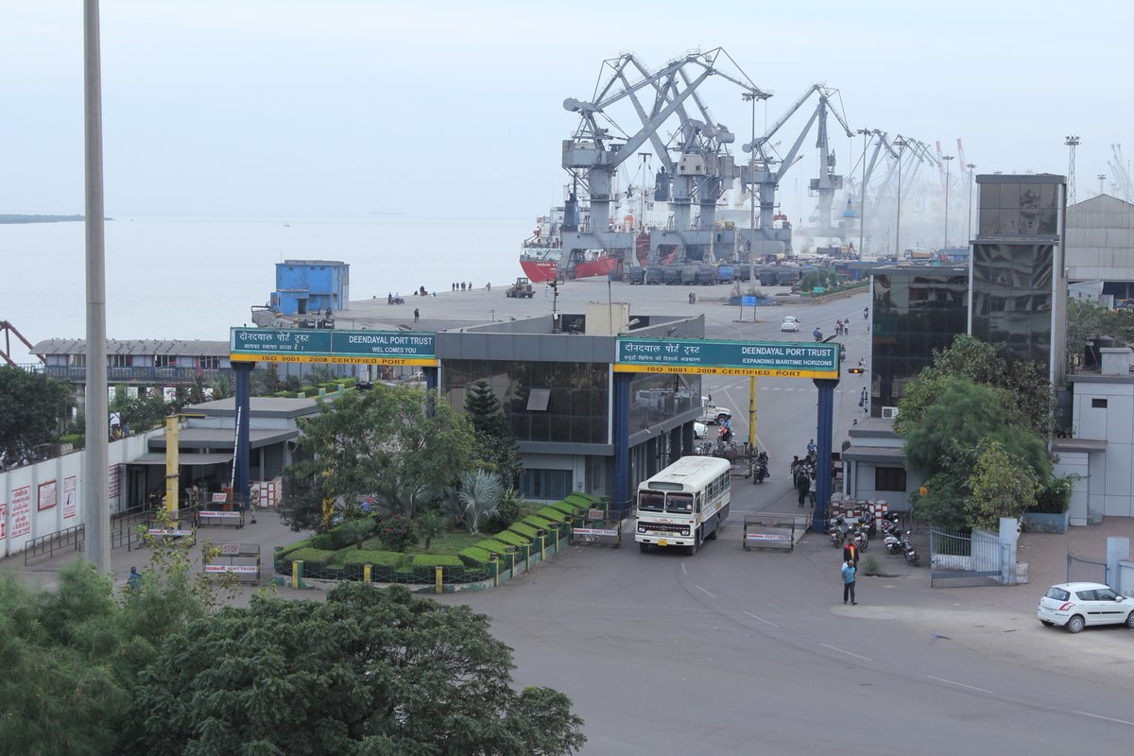
THANK YOU
Deendayal Port Trust

Slide 29
THANK YOU

Slide 30
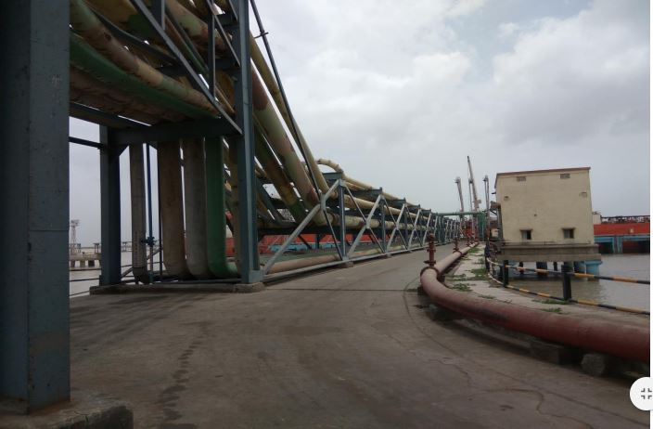
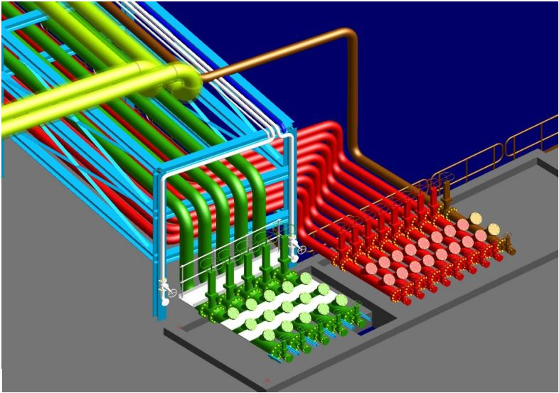
RATIONALIZATION OF PIPELINES
EXISTING CONDITION:-
Existing pipelines laid from jetty head to Y junction are of varied dia and are being owned by different private/ PSU companies.
At present there is a heavy congestion at Y junction as the pipelines of various dia from all the jetties converge at Y Junction.
AIM:-
To reduce the congestion
Safer Port operations with higher efficiency in discharge rate.
It will handle larger number of vessels and enhanced cargo increasing the profitability of the Port.
STATUS:-
M/s MECON Ltd. (A Govt. of India Enterprises) has been appointed as technical advisor.
M/s MECON Ltd. submitted Block estimate amounting to Rs. 170.42 crs which is approved by Board.
After a number of revisions, the Technical advisor has submitted draft tender document on 15.06.2018 which is under departmental concurrence.
Further, prior to execution of the work Environmental clearance is needed as advised by the technical advisor. TOR has been approved by MOEFC for this work.
The NIT for the subject work is expected to be uploaded by August 2018.
Tender for the subject work is expected to be opened in September,2018
After bid evaluation process, the work order for the work is expected to be awarded to the EPC contractor by December,2018 (subject to E.C.).
The work shall be completed within 24 months from date of Issue of work order to the EPC contractor.
CONSTRUCTION OF OIL JETTY NO 7 THROUGH INTERNAL RESOURCES.
Back3
Back5

Slide 31
FIRE-FIGHTING SYSTEM FOR OIL JETTY 1 TO 4
Equipment | Existing | Proposed (to meet new OISD-156 standard)
Fire water pumps | 6 Nos. with capacity 500 cu.m/hr. 2 Nos. with capacity 820 cu.m/hr (all 4 jetties interconnected) | 6 Nos. with capacity 780 cu.m/hr (with interconnected ring circuit)
Jockey Pumps | 2 Nos., with capacity 30 cu.m/hr | 4 Nos. with capacity 120 cu.m/hr
Foam pumps | 2 Nos. 22 cu.m/hr 4 Nos. 15 cu.m/hr | 6 Nos. 22 cu.m/hr
Tower Monitors | OJ-1: Nil OJ-2: 2 Nos. OJ-3: 2 Nos. OJ-4: 2 Nos. | 3 Nos. & 3 Nos. jumbo nozzles 2 Nos. & 2 Nos. jumbo nozzles 2 Nos. & 2 Nos. jumbo nozzles 2 Nos. & 2 Nos. jumbo nozzles
Control Room | Provided for operating tower monitors | Control room for remote operation of entire system of each jetty will be provided.
PRESENT STATUS:-
Oil Jetty No.1 to 4 belong to DPT. At present, the fire fighting system on these jetties are interconnected so that the sea water for fire fighting can be directed from one jetty to any other jetty. The system is 20 – 30 years old, and the system was designed for handling particular type of liquid cargo (POL, chemicals, edible oil etc.). Presently LPG is also being handled at OJ-1.
DPT has appointed consultant (MECON) for upgrading this system to meet the latest OISD-156 (October 2017) guidelines and PESO requirements. The estimate and technical specification for the tender has been submitted by the consultant, which are under scrutiny before submitting for approval of the Board. The salient features of the proposed system are:
CONSTRUCTION OF OIL JETTY NO 7 THROUGH INTERNAL RESOURCES.
Back

Slide 32
CAPACITY AUGMENTATION (GENERAL CARGO)
Sr. No | Existing Berth | Capacity | Proposed Berth | Capacity | Total Capacity (Existing +Proposed) | Timeline of Proposed Jetty
1. | Dry Cargo berths(1 to 10) | 19.54 MMTPA | 14th & 16th Cargo berth | 9.0 MMTPA | 28.54 MMTPA | MAY 2019
2. | 13th & 15th Cargo Berths | 9.0 MMTPA | - | - | 9.0 MMTPA
3. | Container terminal (11 & 12 Cargo Berths) | 7.20 MMTPA (6 lac TEUs 12.5 MT each) | - | - | 7.20MMTPA (6 lac TEUs 12.5 MT each)
4. | IFFCO (Captive) | 2.00 MMTPA | - | - | 2.00 MMTPA
5. | Bunder Basin | 5.11 MMTPA | - | - | 5.11 MMTPA
6. | Dry Bulk Terminal | 14.112 MMTPA | - | - | 14.112 MMTPA
7. | Harbour Mobile Cranes & Floating Cranes | 45.0 MMTPA | - | - | 45.0 MMTPA
 | Total Capacity | 56.962 MMTPA |  | 9.0 MMTPA | 65.962 MMTPA
CONSTRUCTION OF OIL JETTY NO 7 THROUGH INTERNAL RESOURCES.
Back

Slide 33
CAPACITY AUGMENTATION (LIQUID CARGO)
KANDLA
Sr.No | Existing Oil Jetties | Capacity | Proposed Oil Jetties | Capacity | Total Capacity (Existing +Proposed) | Timelines of Proposed Jetties
1. | OIL JETTIES (1 TO 6) | 13.33 MMTPA | OIL JETTIES (8 TO 11) OIL JETTY -7 | 3.5 x 4 =14 MMTPA 2 MMTPA | 29.33 MMTPA | Oil Jetty # 7 – May ’20 Oil Jetty # 8 – June ’21 Oil Jetty # 9 – Dec ’21 Oil Jetty # 10 & 11 – July ’22
2. | - | - | OIL JETTY CUM BUNKERING | 3.39 MMTPA | 3.39 MMTPA | Dec 2020.
 | TOTAL CAPACITY | 13.33 MMTPA |  | 19.39 MMTPA | 32.72 MMTPA
VADINAR
Sr.No | Existing Oil Jetties | Capacity | Proposed Oil Jetties | Capacity | Total Capacity (Existing +Proposed) | Timelines of Proposed Jetties
1. | IOC SBM i.e (SBM 1 & 2) | 22.50 MMTPA | - | - | 22.50 MMTPA | -
2. | ESSAR SBM(SBM 3) | 19.95 MMTPA | ESSAR SBM(SBM 1) | 14.5 MMTPA | 34.45 MMTPA | Dec 2021 (Subject to Receipt of EC by Dec 2018)
3. | ESSAR PRODUCT JETTY | 14.50 MMTPA | ESSAR PRODUCT JETTY (2 Nos.) | 5 X 2= 10 m | 24.50 MMTPA
 | Total | 56.95 MMTPA |  | 24.5 MMTPA | 81.45 MMTPA
CONSTRUCTION OF OIL JETTY NO 7 THROUGH INTERNAL RESOURCES.
Back

Slide 34
5. REVENUE & PROFITABILITY
Kandla & Vadinar (Consolidated)
 | Actual 16-17 | Actual 17-18 | Target 18-19 | Actual April,18 to June,18
Operating Income (Rs. Crore) | 1383.15 | 1475.35 | 1579.80 | 410.82
Operating Expenses (Rs. Crore) | 658.79 | 677.99 | 682.92 | 170.86
Operating Surplus (Rs. Crore) | 724.36 | 797.36 | 896.88 | 239.95
Operating Margin (%) | 52.37 | 54.05 | 56.77 | 58.41
Net Surplus (Rs Crore) | 693.86 | 546.45 | 765.76 | 172.88
Net Margin (%) | 44.14 | 31.47 | 41.93 | 37.20
Cost Per Ton (Rs.) | 62.48 | 61.58 | 60.98 | 58.66
BACK

Slide 35
REVENUE & PROFITABILITY (KANDLA)
 | Actual 16-17 | Actual 17-18 | Target 18-19 | Actual April,18 to June,18
Operating Income (Rs. Crore) | 1059.80 | 1146.94 | 1245.73 | 328.49
Operating Expenses (Rs. Crore) | 594.01 | 601.73 | 615.83 | 152.57
Operating Surplus (Rs. Crore) | 465.79 | 545.21 | 629.90 | 175.93
Operating Margin (%) | 43.95 | 47.54 | 50.56 | 53.56
Net Surplus (Rs Crore) | 309.31 | 284.49 | 377.30 | 76.58
Net Margin (%) | 27.90 | 20.81 | 27.75 | 22.36
Cost Per Ton (Rs.) | 121.70 | 113.66 | 114.36 | 103.02
Back

Slide 36
REVENUE & PROFITABILITY (VADINAR)
 | Actual 16-17 | Actual 17-18 | Target 18-19 | Actual April,18 to June,18
Operating Income (Rs. Crore) | 323.35 | 328.40 | 334.07 | 82.33
Operating Expenses (Rs. Crore) | 64.78 | 76.25 | 67.09 | 18.30
Operating Surplus (Rs. Crore) | 258.57 | 252.15 | 266.98 | 64.03
Operating Margin (%) | 79.97 | 76.78 | 79.92 | 77.78
Net Surplus (Rs Crore) | 384.55 | 261.96 | 388.46 | 96.29
Net Margin (%) | 83.03 | 70.95 | 80.89 | 78.81
Cost Per Ton (Rs.) | 11.44 | 13.34 | 12.78 | 12.78
Back

Slide 37
PROJECTS FOR AWARD IN 2018-19
S. No. | Name of the Project | Investment (Cr.) | Capacity (MTPA) | Present Status
1 | Mechanization of fertilizer handling at Berth no. 14 | 338.51 | 4.50 | The SFC has approved the project as communicated, vide MoS letter dated 5.6.2018. The bidding documents are under preparation/ scrutiny. Project is scheduled to be awarded by Oct ’18 and to be completed by Oct’20.
2 | Development of Oil Jetty No.8 at Old Kandla through internal resources | 150.00 | 3.50 | A) Environmental clearances. TOR issued by the MoEF& CC, GOI, on 04.08.2017. NOC for GPCB online application submitted on 02.02.2018. Application for CRZ recommendation submitted to the GCZMA on 1.03.2018. Technical Committee of GCZMA discussed the proposal and asked for certain details on 12.04.2018. DPT submitted required details to CRZ Authority on 18.05.2018. GCZMA included the proposal on 12.06.2018 & decided to carry out site inspection by the sub-committee. CRZ recommendation awaited.
.
Back

Slide 38
PROJECTS FOR AWARD IN 2018-19 (Contd.)
S. No. | Name of the Project | Investment (Cr.) | Capacity (MTPA) | Present Status
 |  |  |  | (B) Technical Consultant LOA issued on 05/06/2017 to M/s URS Scott Wilson India Pvt Ltd. for Technical Consultancy Services. DPR and Block estimate received on 15/09/2017. Observations raised by the DPT on DPR and block estimate have been complied. Revised block estimate has been approved by the Board at its meeting held on 26.12.2017 (C) Award of Work Issue of NIT – 01/02/2018 Pre-bid meeting held on 08.02.2018. Technical bid was opened on 08.03.2018. Three bids were received. All three bidders have been qualified. Proposal for approval of technical qualification of bidders submitted. The award of work will be subject to Environmental Clearance. (Spill over project)
.
Back

Slide 39
PROJECTS FOR AWARD IN 2018-19 (Contd.)
S. No. | Name of the Project | Investment (Cr.) | Capacity (MTPA) | Present Status
3 | Solar Power Plant of 175 KWP decentralized Grid connected on roof top | 1.80 | - | In the 1st attempt LoI was issued on 20.01.2017. However, the successful bidder backed out saying that the company has wound up. In the 2nd attempt, technical bids were opened on 26.09.2017. The price bids of 8 technically qualified bidders were opened on 17/01/2018. However, as the L1, L2 & L3 parties have not quoted the prices as per the BoQ, the tender was discharged and re-invited. In the third attempt, bids have been opened on 28.02.2018. 15 bids received The proposal for placement of order on the L-1 bidder has been submitted. Approval is awaited. (Spill over project)
.
Back

Slide 40
PROJECTS FOR COMPLETION IN 2018-19
S. No. | Name of the Project | Investment (Cr.) | Capacity (MTPA) | Present Status
1 | Deployment of two Mobile Harbour Cranes | 94.00 | 3.50 | Completed (Spill over project)
2 | Mechanization of fertilizer bagging and wagon loading | 122.03 | 1.40 | Completed (Spill over project)
3 | Setting up of a 14MW wind power project. | 147.00 | - | All 7 WTGs Erection completed and are ready for commissioning Permission from GEDA for commissioning of WTGs awaited The sub-lease agreement for land has been executed on 04.07.2018. Expected to be commissioned by Sep’18
.
Back

Slide 41
PROJECTS FOR AWARD IN 2018-19 (Contd.)
S. No. | Name of the Project | Investment (Cr.) | Capacity (MTPA) | Present Status
4 | The providing rail connectivity to berth No. 13,14,15 & 16 from take off point to Western end of berth | 109.03 | - | The work awarded to M/s. IPRCL for execution. The ground treatment work is in progress. The tender for laying railway lines has already been invited by M/s. IPRCL
5 | Solar Power Plant of 175 KWP decentralized Grid connected on roof top | 1.80 | - | In the 1st attempt LoI was issued on 20.01.2017. However, the successful bidder backed out saying that the company has wound up. In the 2nd attempt, technical bids were opened on 26.09.2017. The price bids of 8 technically qualified bidders were opened on 17/01/2018. However, as the L1, L2 & L3 parties have not quoted the prices as per the BoQ, the tender was discharged and re-invited. In the third attempt, bids have been opened on 28.02.2018. 15 bids received The proposal for placement of order on the L-1 bidder has been submitted. Approval is awaited.
 | Total | 473.86 | 4.90
Back

Slide 42
RFD Targets 2018-19 (DPT Kandla)
S.No. | Objective | Unit | Actual 2016-2017 | Target 2017-18 | Actual 2017-18 | Target 2018-19
1 | Overall Avg Turnaround Time (TRT) | Hours | 105.60 | 91.20 | 60.24 (based on readiness – BERMAN application) | 59.00
2 | Average Ship Berth Day Output (SBDO) | Tonnes | 18464 | -- | 18531 | 19000
3 | Overall Volume of Cargo throughput | MMT | 105.44 | 106.00 | 110.099 | 112
4 | Operating Ratio | % | 47.53 | 47.00 | 45.95 | 46.00
5 | Cost Per Tonne Handling | Rupees | 62.48 | 62.50 | 61.58 | 60.00
6 | Operating Surplus | Rs. (In Cr) | 698.60 | 700.00 | 797.36 | 820.00
.
Back

Slide 43
RFD Targets 2018-19 (DPT Kandla)
S.No. | Objective |  | Unit | Actual 2016-2017 | Target 2017-18 | Actual 2017-18 | Target 2018-19
7 | Reduction in Expenditure:
 | CISF | % |  | -23.00 | 6.00 | 3.82 | 1.00
 | OTA |  |  | 23.82 | 6.00 | -2.40 | 1.00
 | Medical Expenses |  |  | -20.24 | 4.20 | -5.45 | 1.00
 | Any Other Item (Pl. Specify) |  |  | -- | - | - | --
8 | Award of Projects (Details in separate slide) | Nos |  | -- | 2 | 1 | 3
 |  | Investment (Rs. in Cr) |  | -- | 350.00 | 200.00 | 490.37
 |  | Capacity (MMTPA) |  | -- | 3.50 | - | 8.00
.
Back

Slide 44
RFD Targets 2018-19 (DPT Kandla)
S.No. | Objective | Unit | Actual 2016-2017 | Target 2017-18 | Actual 2017-18 | Target 2018-19
9 | Completion of Projects (Details in separate slide) | Nos | -- | 2 | 1 | 5
 |  | Investment (Rs. in Cr) | -- | 215.18 | 122.03 | 474.19
 |  | Capacity (MMTPA) | -- | 4.90 | 1.40 | 4.90
10 | Berth Productivity Crane productivity (Container Handling) Average No. of Moves per crane hour | No. of Moves per hour | 25.27 | 25 (as per CA) | 29.28 | 25 (as per CA)
 | Discharge rate (Edible Oil and chemicals) | MT per hour | 416 | 400 | 403 | 425 (as per RFD)
11 | Leasing of Lands
 | Renewal of expired leases | Nos. | -- | -- | -- | 05
 | Tender-cum-auction of expired leases | Nos. | -- | -- | -- | 32
 | Utilization of vacant land/plots | Nos | -- | -- | -- | 16
.
Back

Slide 45
RFD Targets 2018-19 (DPT Kandla)
S.No. | Objective | Unit |  | Actual 2016-2017 | Target 2017-18 | Actual 2017-18 | Target 2018-19
12 | Pension Fund
 | Reduction in pension liability fund. | Rs. in Crore |  | -- | -- | -- | 356.91
 | Action plan for reducing pension liability As far as DPT is concerned, the Superannuation Fund has already been created. Total Fund as on 31.03.2018 is Rs. 578.61 Cr. Actuarial valuation as on 01.04.2018 is Rs. 935.52 Cr. Therefore, Gap Funding for the year 2018-19 amounting to Rs. 356.91 Cr will be met by March, 19.
13 | Transhipment of Containers (Recent notification dated 21.5.2018)
 | Reduction in Transhipment taking place in foreign ports |  | Tonnes | -- | --
 | Increase in Transhipment from Indian Ports |  | Tonnes | -- | -- | 557 MT 35 TEUs | 3246 MT 204 TEUs
 | Increase in Coastal Traffic |  | Tonnes | 7.4 MMT | 9.0 MMT | 11.3 MMT | 12.5 MMT
.
Back

Slide 46
AWARD OF PROJECTS 2018-19 (DPT - KANDLA)
AWARD OF PROJECTS 2018-19 (DPT - KANDLA)
Sr. No. | Name of the project | Investment (Rs. In Cr.) | Capacity (MMTPA)
1 | Development of Oil Jetty no. 8 at Old Kandla through Internal resources | 150.00 | 3.50
2 | Mechanization of fertilizer handling at Berth no. 14 | 338.51 | 4.50
3 | Solar Power Plant of 175 KWP decentralized grid connected on roof top of AO Building. | 0.75 | -
 | Total | 489.26 | 8.00
Back

Slide 47
COMPLETION OF PROJECTS 2018-19 (DPT - KANDLA)
Sr. No. | Name of the project | Investment (Rs. In Cr.) | Capacity (MMTPA)
1 | Deployment of two Mobile Harbour Cranes (Completed). | 94.00 | 3.50
2 | Setting up of a 14MW wind power project (September 2018). | 147.00 | -
3 | Mechanization of fertilizer bagging and wagon loading (July 2018) | 122.03 | 1.40
4 | Rail Connectivity from takeoff point to western corner of Berth No. 13 to 16(September 2019). | 109.30 | -
5 | Solar Power Plant of 175 KWP decentralized grid connected on roof top of AO Building (December 2018). | 1.86 | -
 | Total | 474.19 | 4.90
Back

Slide 48
FINANCIALS
Operating income is increased from Rs.885 crore to Rs. 1475 crore in 2017-18.
Operating surplus is increasing regularly.
Operating margin is increasing regularly.
Net income increase by 12 times.
Back

Slide 49
7. IT INITIATIVES
# | Name | Description | Timeline
1 | ERP | Deendayal Port Trust is one of the Ports participating in ERP project for Six Major Ports to be finalized by IPA, New Delhi. The System Integrator to be appointed by IPA, New Delhi, for implementation of ERP. | July 2019
2 | E-Office and E-Platform | The case has been submitted for Technical, Administrative and Budgetary Sanctions from competent authority. The draft Expression of Interest and Draft DTPs have also been submitted for Finance concurrence and Administrative approval of competent authority. The Project is envisaged to Go Live by Dec., 2018. | Dec 2018
3 | Port Community System (PCS) 1 Plus | DPT is operating a Help desk for last two years for facilitating smooth operations of PCS for the Port Users. The difficulties faced by the Port Users and expectation of the Port & Port Users, in line with latest online Platforms / applications, for Ease of Doing Business, have been communicated to the PCS team through Joint Meeting with Port Users, PCS team and Port Officials headed by Dy. Chairman, DPT. The upgradation to PCS 1.x Project is handled by IPA, New Delhi. The system Integrator “M/s. Portall” has commenced the work and the Port is awaiting upgradation guided by the System Integrator “M/s. Portall”. | Dec 2018 IPA is executing the work.
4 | Port Community System (PCS) 2.0 | PCS 2.0 is a Central Govt. project for all Major Ports which will have new architecture, design & covering other trade requirements in line with International Conventions for Harmonized Trade Platforms. DPT’s EDP team has provided necessary initial information and expectations for PCS 2.0. The Port has called for nomination in the Working Group for the purpose of implementation of PCS 2.0 from stakeholders. M/s. E&Y have been appointed as Consultant by the IPA, New Delhi. | IPA is executing the project.
Back

Slide 50
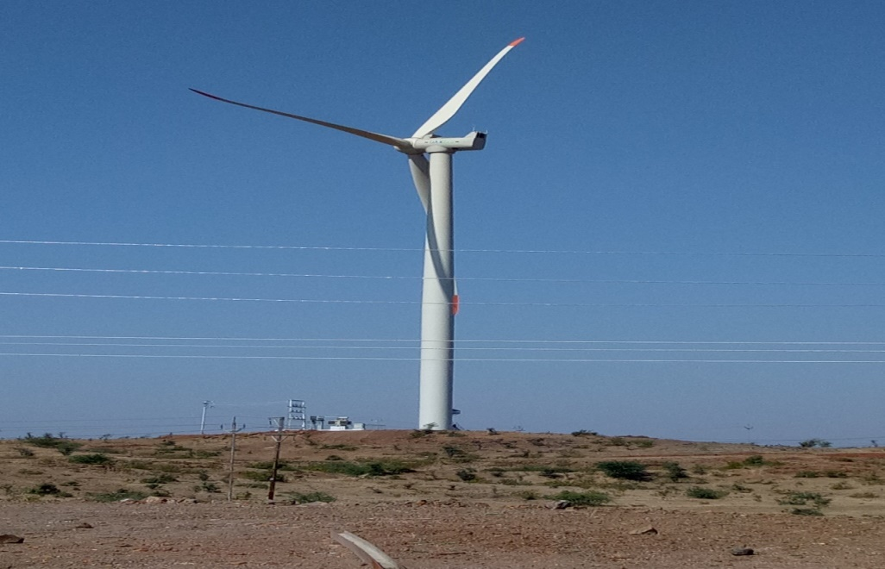
6 MW WIND POWER PROJECT
Investment | Capacity
₹. 63.59 cr. | 6 MW
3 Nos. of turbines have been set up in village: Sukhpur, Dist: Amreli, Gujarat. Project commissioned on 31.03.2017 For captive consumption of DPT.
The estimated generation capacity of the wind farm is 1.45 cr. units per year. With this project, reduction of 13000 Tonnes of CO2 emissions each year will be achieved, thereby contributing to the saving of earth’s environment.
Back

Slide 51
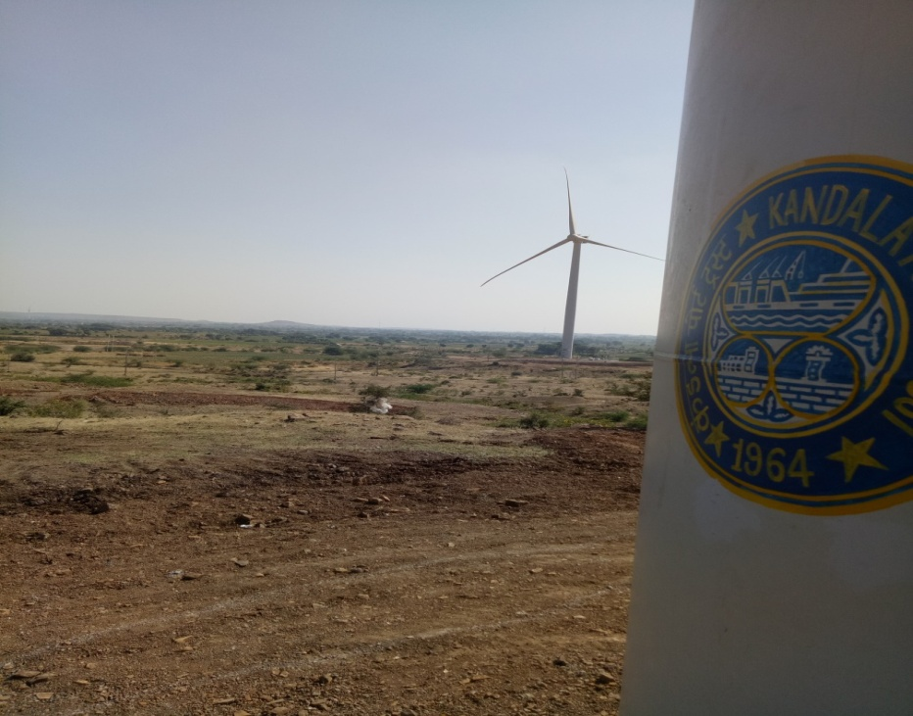
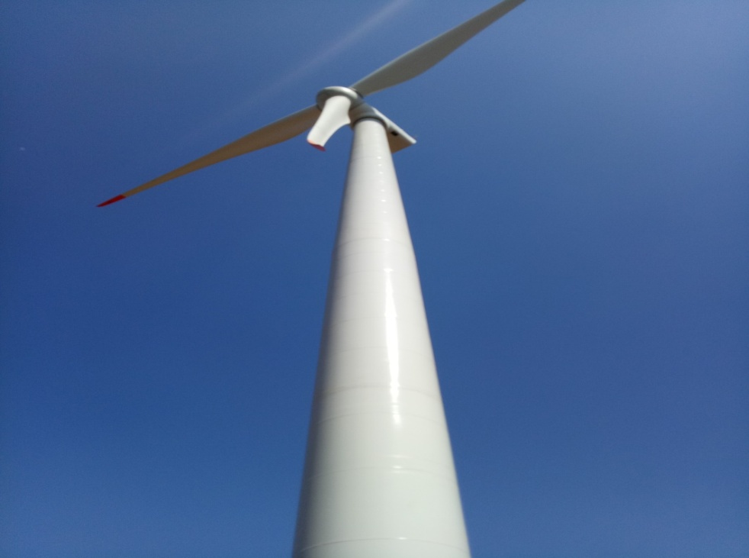
6 MW WIND POWER PROJECT
Back

Slide 52
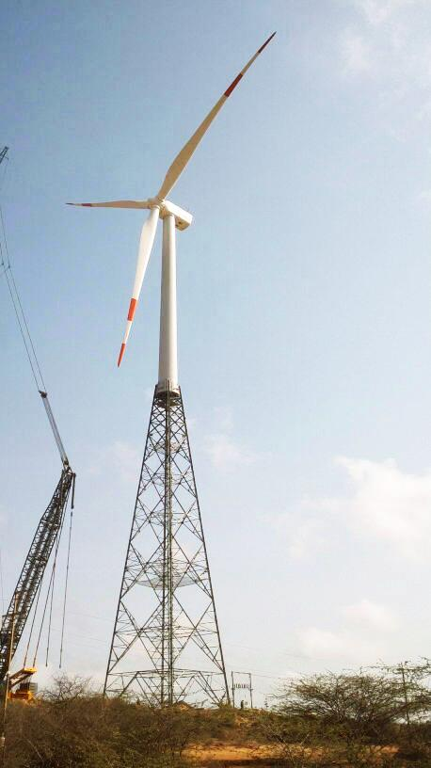
14 MW WIND POWER PROJECT
Investment | Capacity
Total cost : Rs.142.32 crores Capital Cost : Rs.96.86 crores O&Mcost : Rs.45.46 crores | 14 MW
7 nos. Wind Turbines to be installed of 2.1 MW each
Estimated Annual Energy Production – 3.9 crore units
With this project, reduction of approximately 30000 Tonnes of CO2 emissions each year will be achieved, thereby contributing to the saving of earth’s environment
Partly for captive consumption and remaining for sale to third party.
Back

Slide 53
CONSTRUCTION OF OIL JETTY 7
LOA issued for :- Rs. 42.40 Cr
Estimated Capacity :- 2 MMTPA
STAGES/MILESTONES:-
Sr. no | Stages/Milestones | Target Date
1 | Issue of NIT | 07/05/2015
2 | Approval of detailed Estimate and hosted on DPT Website. | 20/05/2015
3 | Pre-bid meeting | 04/06/2015
4 | Bid Submission and opening of Tech bid | 30/06/2015
5 | Opening of Price bid | 12/08/2015
6 | Issue of Work Order | 26/10/2015
M/s. Kargwal Construction Co., Mumbai have been issued LOI on 14.09.2015.
Work order issued on 26.10.2015.
CRZ and Environmental Clearances are awaited.
The Expert Appraisal Committee (Infra.2) has recommended the proposal in its meeting held on 25/1/2018 (Minutes uploaded on the website on 5/2/2018) for grant of EC & CRZ Clearance, subject to final outcome of the NGT Order dated 22/11/2017 in O.A. 424/2016. The EC & CRZ Clearance from MoEF&CC, GoI is awaited.
PRESENT STATUS:-
CONSTRUCTION OF OIL JETTY NO 7 THROUGH INTERNAL RESOURCES.
STATUS OF EC
&
CRZ CLEARANCE :-
Back

Slide 54
CONSTRUCTION OF OIL JETTY 8
Estimated Cost :- Rs. 150 Cr.
Estimated Capacity :- 3.50 MMTPA
PRESENT STATUS:-
A) Environmental clearances.
TOR issued by the MoEF& CC, GOI on 04.08.2017.
GPCB has granted NOC. Application for CRZ recommendation submitted to the GCZMA on 1.3.2018.
Technical Committee of GCZMA discussed the proposal and asked certain details on 12.04.2018.
DPT submitted required details to CRZ Authority on 18.05.2018.
GCZMA included the proposal on 12.06.2018 & decided to carry out site inspection by the subcommittee. CRZ recommendation awaited.
(B) Technical Consultant
LOA issued on 05/06/2017 to M/s URS Scott Wilson India Pvt Ltd.
DPR and Block estimate received on 15/09/2017.
Observation raised by DPT on DPR and block estimate have been complied. Revised block estimate has been approved by the Board in its meeting held on 26.12.2017
STAGES/MILESTONES:-
Sr. no | Stages/Milestones | Target Date
1 | Issue of NIT | 01.02.2018
2 | Pre bid meeting | 08.02.2018.
3 | Opening of Technical Bid | 08.03.2018
4 | Opening of Price bid | The proposal for technical qualification of bidders is under approval.
5 | Award of work | The work will be awarded subject to Environmental Clearance.
Back

Slide 55
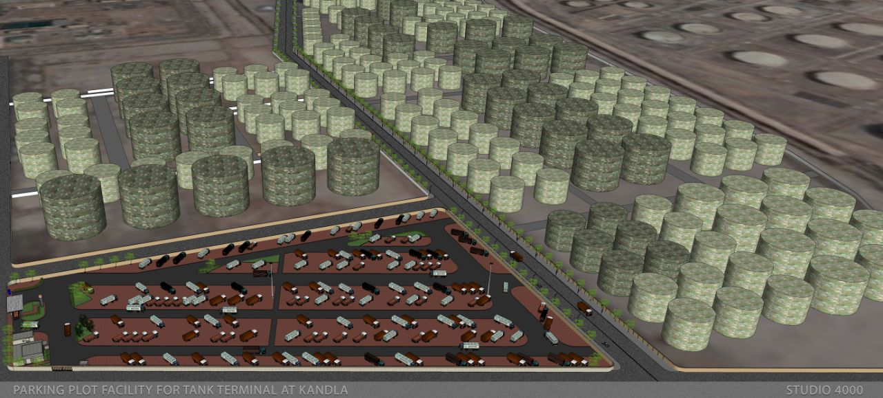
PARKING PLOT AT LIQUID STORAGE TANK
Estimated Cost:- 10.27 Cr
Estimated Capacity :- 500 Trucks.
Present Status:-
DPT had initiated action for allotment of vacant plots for various purposes at Kandla through E-Tender-cum-E-Auction. 15 Plots were allotted for Liquid Storage tanks.
Allottees of these 15 Nos. of liquid storage tanks had desired that there should be a facility for providing truck parking, canteen, restaurant, Toilets and other related ancillary facilities in the vicinity of 19 nos. of plots earmarked for liquid storage tanks.
Accordingly, a meeting was convened with the Kandla Liquid Tank Terminal Association on 07-11-2016, wherein was as desired to provide various facilities like truck parking, canteen, restaurant, toilets and other related ancillary purposes.
In order to cater to the demand of Kandla Liquid Tank Terminal Association plots admeasuring 43,543/- sq.mtrs were earmarked for providing necessary facilities for liquid storage Tank Plots.
Tender were invited for the work of Providing Infrastructure Facility in Liquid Storage Tank at Kandla with the approval of the Board.
Work is under progress and the facility shall be operational within one month. Around 500 vehicles can avail the facility of this infrastructure facility.
CONSTRUCTION OF OIL JETTY NO 7 THROUGH INTERNAL RESOURCES.
19 No. of plot for Liquid Storage Hub
Back16
Back

Slide 56
CONSTRUCTION OF OIL JETTY NO 7 THROUGH INTERNAL RESOURCES.
Back
Back

Slide 57


MECHANIZED BAGGING & WAGON LOADING FACILITY FOR FERTILIZER AT NG 34, KANDLA
Need for the facility: To reduce the rake turnaround time from 10 - 12 hours to 6 hours
The Mechanized bagging and rake loading facility at NG 34: 20 nos. bagging machines & 20 nos. wagon loaders
Designed capacity: 1.4 MMTPA fertilizer cargo.
Total Project Cost: Rs. 122 Crores (Capital cost: Rs.14 cr, O & M cost for 8 years: Rs.108 Cr)
Benefits:
Reduction in rake turnaround time to 6 hrs.;
Cost of handling per ton - Rs.160/ ton;
Reduction in handling cost by about Rs. 45/ ton.
Bagging & stitching units
Present Status:
work order was issued to M/s. Rishi Shipping on 31.3.2017.
All the 20 units have been erected and testing & trials are in progress.
Full Commercial Operation by 15.7.2018.
Wagon loaders
BACK

Slide 58
            MECHANIZED HANDLING FACILITY FOR FERTILIZER
            AT BERTH NO. 14 OF DEENDAYAL PORT
  Total Project Cost : Rs. 338.51 Crores to be met from
  internal resources.
  Estimated capacity: 4.5 MMTPA
                Need for the facility:
Master plan of AECOM to reduce turn around time of ships, rake turn around time, etc., by full scale mechanization for handling fertilizer
Currently, process of handling of fertilizer cargo involves multiple movements and agencies within the port.
To ensure faster unloading and delivery of the cargo to the end users, Port has taken up the project for setting up a fully mechanized handling facility exclusively for fertilizer cargo (Urea, MOP, DAP) at Kandla.
Present Status:
Proposal has been approved by Ministry of Shipping as per the recommendation of Standing Finance Committee.
Bidding documents are under preparation / scrutiny.
Project is scheduled to be awarded during FY 2018-19 by Oct 2018 and for completion by March, 2020.
Mobile hopper
BACK

Slide 59
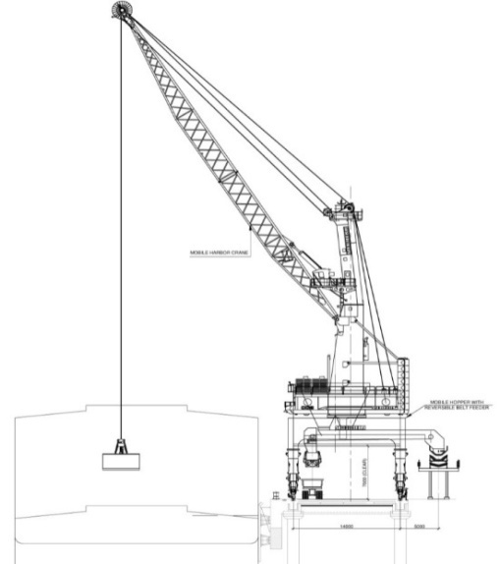
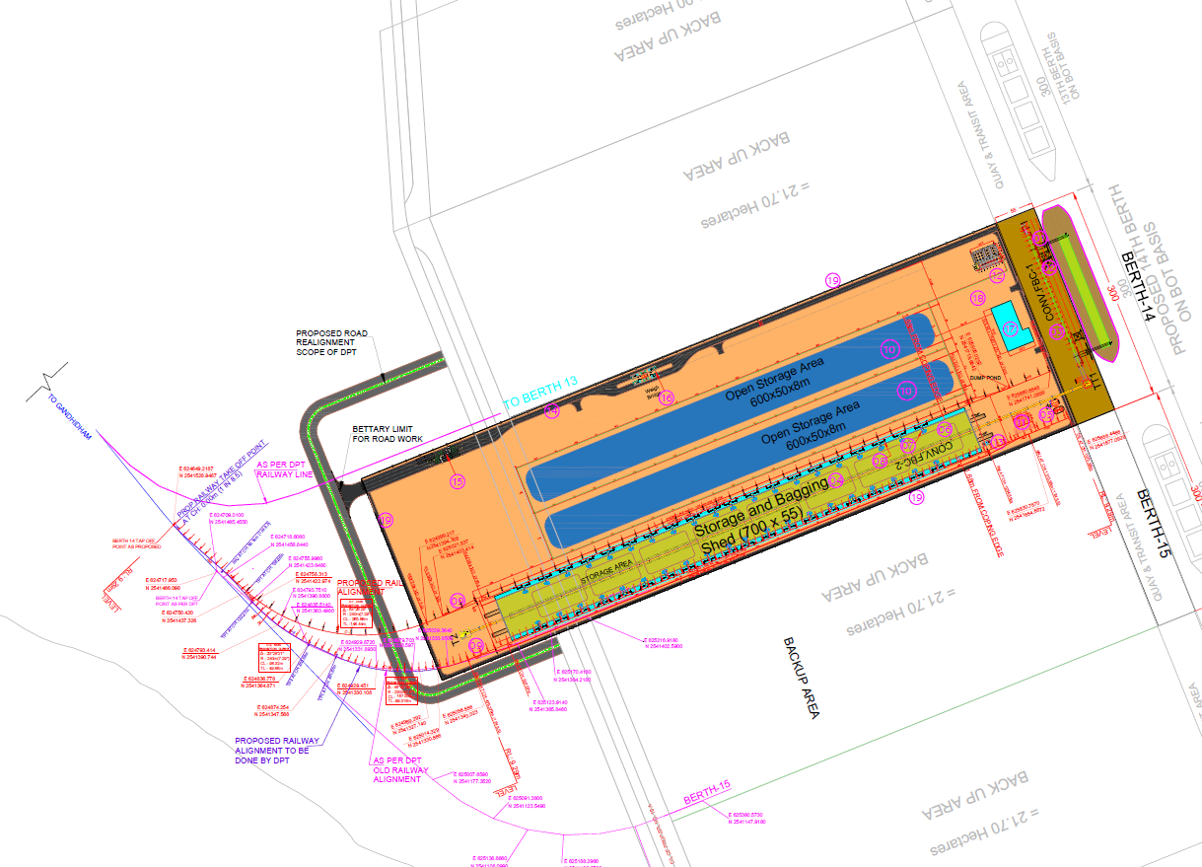
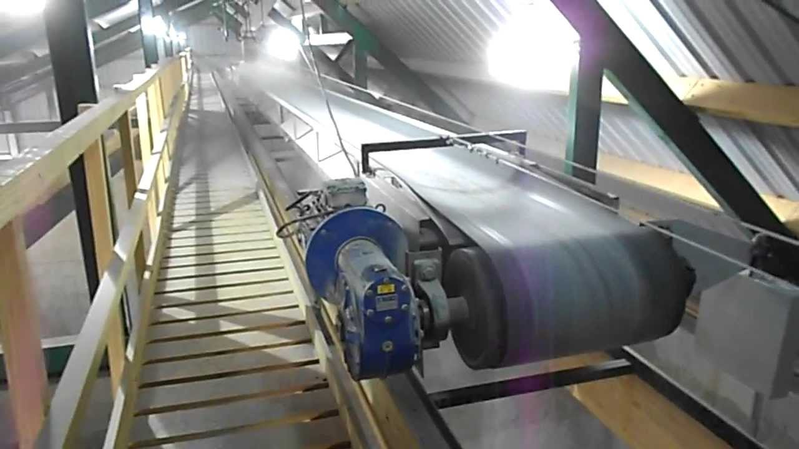
            MECHANIZED HANDLING FACILITY FOR FERTILIZER
            AT BERTH NO. 14 OF DEENDAYAL PORT
Proposed Layout
Mobile Harbour Crane
Salient Features:
2 Mobile harbour cranes with mobile hoppers,
Conveyor system upto storage shed,
Shed of 38,500 Sq.mtrs, 40 Bagging units and Wagon loaders,
2 Rakes can be handled at a time on either side of the shed.
Conveyor System
BACK

Slide 60

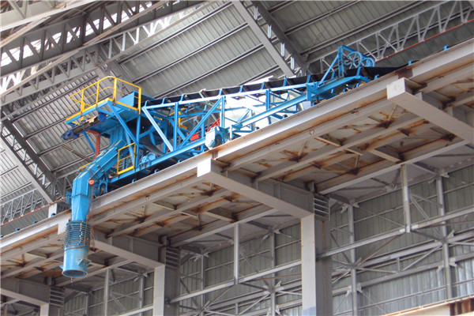
            MECHANIZED HANDLING FACILITY FOR FERTILIZER
            AT BERTH NO. 14 OF DEENDAYAL PORT
            The benefits of the proposed facility will be:
Efficient operation due to end to end mechanization.
No contamination of fertilizer cargo due to dedicated mechanization and closed Pre Engineered Building (PEB) Shed.
No internal Vehicular movement for transfer of cargo
Less number of labour required due to Mechanization and no multiple handling.
One time transfer through equipment and conveyor.
Mechanized Dust Suppression to avoid dust
Lower rake turn-around time
Lower vessel turn-around time
Lower logistics cost
Storage shed
Cargo tripper
BACK

Slide 61
            DEPLOYMENT OF 2 NOS. OF MOBILE HARBOUR CRANES OF 120 TONS CAPACITY
Need for the facility: for flexible, better, faster handling of cargo and to improve the overall efficiency of the port
Total Project Cost:
Equipment Cost: Rs. 71 crores excluding IGST
O & M cost: Rs. 20 crores for 5 Years
Salient features:
Capacity : 120 tons
No. of grabs : 6 nos. (3 x 35 cbm & 3 x 22 cbm)
The cranes have been deployed between Berths no. 7 to 9 of Deendayal Port.
Estimated capacity: 3.5 MMTPA
Present Status:
LoA for procurement issued to M/s. Italgru on 22.05.2017.
Cranes have been commissioned on 07.05.2018 after completion of tests and trials.
MHC
BACK

Slide 62
            STATUS OF SIPC
Master plan for both the locations of the SIPC has been prepared and approved by the Board of Trustees.
Programme Management Consultant, Marketing consultant & Design Consultant have been appointed
Environment Clearance from MoEF&CC for both the locations have been received and NOC from GPCB for the locations has also been received.
TAMP has approved market rate of land of Rs.900 per sq.mtr. for location 2.
PIB approval for the location 2 has been received.
Work of land filling at location 2: Work order issued. Work is started on 01.06.2018 and under progress.
Auction of the plots at location 2(Phase-I): Technical Bid opened on 30.05.2018, three bids received. Price bids to be opened on 17.07.2018
BACK

Slide 63
            PLOT PLAN – LOCATION 1 (RESIDENTIAL)
The above zoning plan is tentative and KPT proposes to have flexibility to subdivide and/ or merge the plots depending upon the market requirement and investor’s acceptability.
BACK

Slide 64
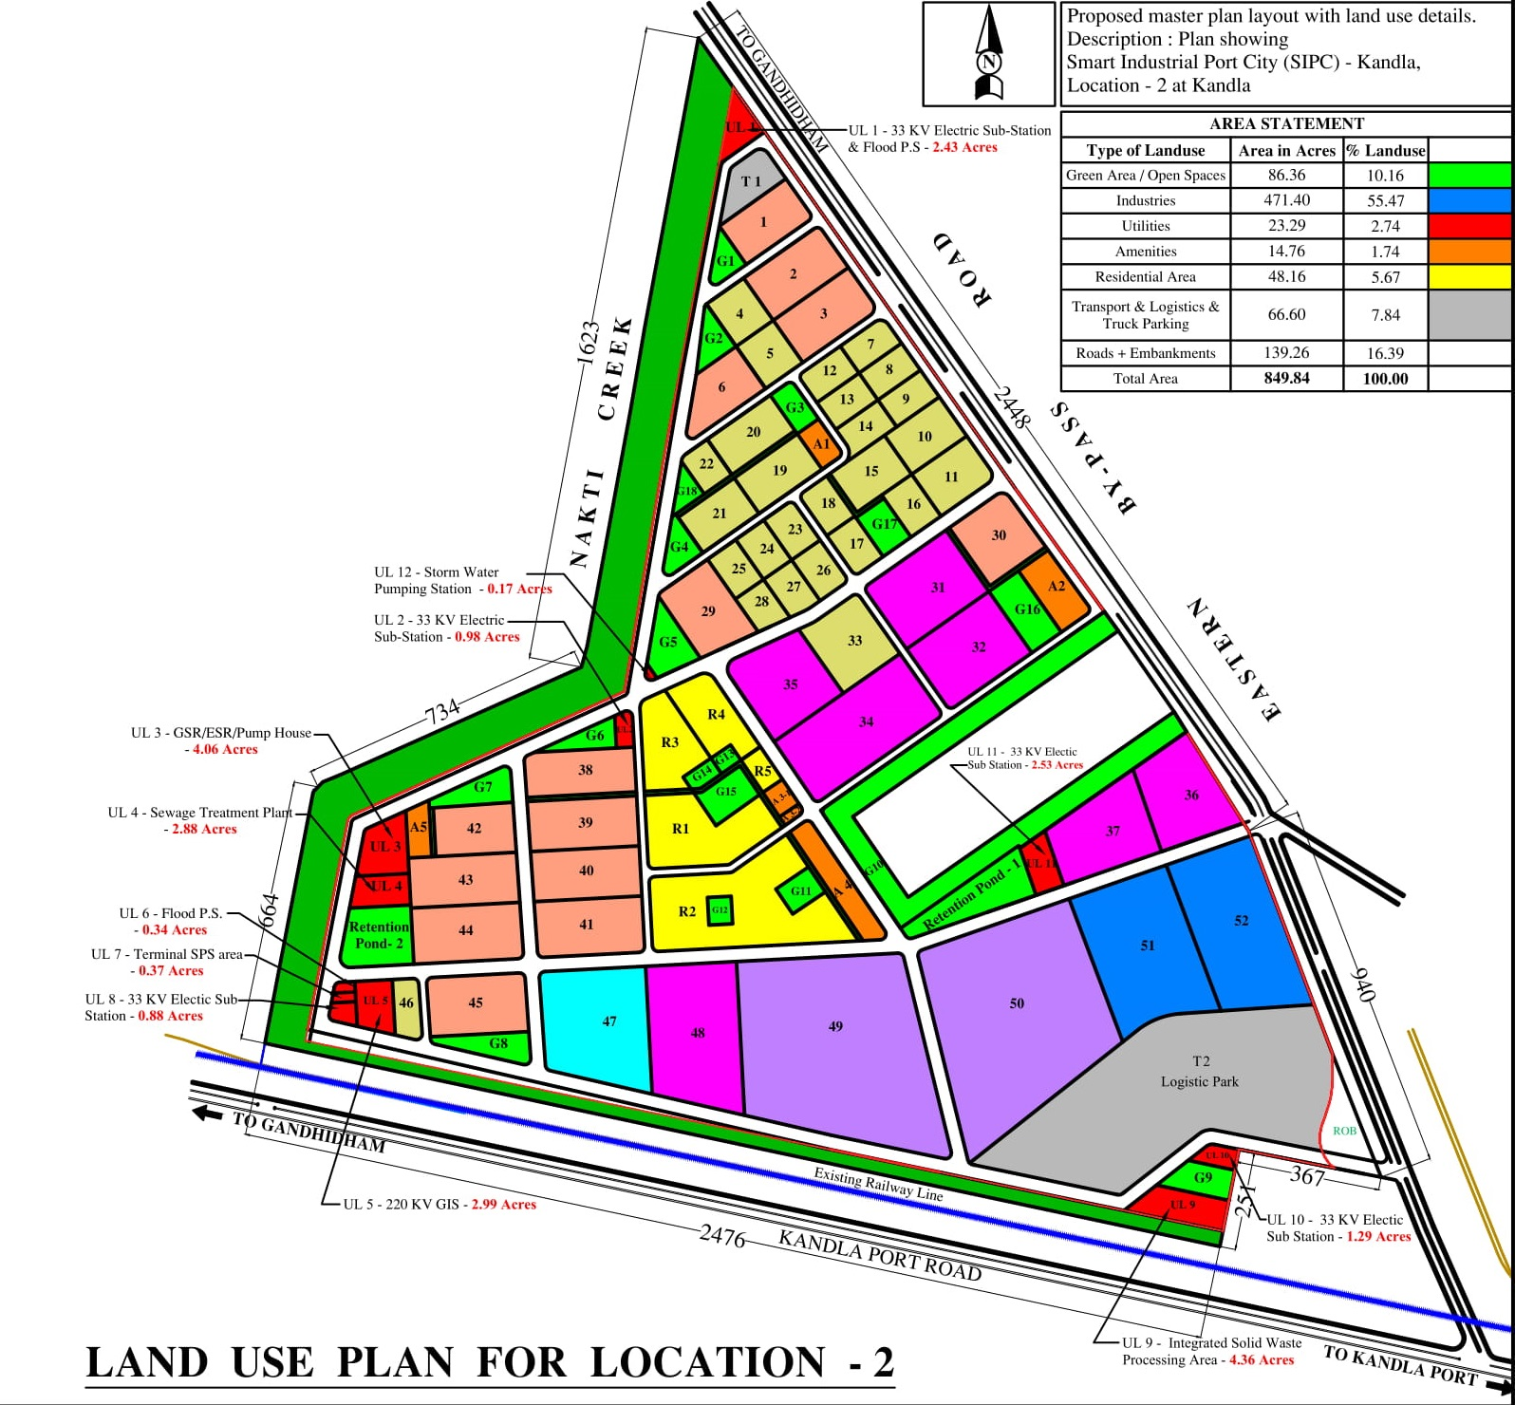
            PLOT PLAN – LOCATION 2 (INDUSTRIAL ZONE)
BACK

Slide 65
            WATER SPRINKLING SYSTEM
Name of Project: Sprinkling system inside Cargo Jetty area for Coal Dust
Suppression in Coal Yard.
Tender Cost : Rs.14.44 Crores.
Time Period : 12 Months for Supply and commissioning and
maintenance 5 years (O&M)
Aim: To reduce the Coal dust in Operational area to comply with the GPCB/MoEF norms to prevent Dust pollution.
Supply, installation, Testing and commissioning along with Five Year Annual maintenance and operation of complete system.
Area considered under the project : 9 plots of 31,078 sq. mtrs each
No. of Sprinklers: 36 (4 sprinklers in each plot) with a capacity of releasing 3636 litres per minute.
Project Capacity of water sprinkling: 4,34,574 litres of water will be sprinkled per day
Total Area considered : 40 Hectare
Period of completion: 12 months + 5 years Operation and maintenance
PRESENT STATUS: WORK COMPLETED.
BACK
BACK

Slide 66
5 YEARS TOTAL TRAFFIC PROJECTION (MMT)
YEAR | TOTAL TRAFFIC PROJECTIONS (MMT) | ESTIMATED GROWTH
2017-18 | 110.10 (Actual) | -
2018-19 | 113.40 | 5%
2019-20 | 119.07 | 5%
2020-21 | 125.02 | 5%
2021-22 | 131.27 | 5%
TRAFFIC PROJECTIONS (MMT)
BACK

Slide 67
TRAFFIC PROJECTION (MMT)
 | TRAFFIC HANDLED |  |  |  | TRAFFIC PROJECTION
 | 2014-15 | 2015-16 | 16-17 | 17-18 | 18-19 | 19-20 | 20-21 | 2021-22
POL (inc. POL & crude oil at Kandla & vadinar, plus trans.) | 55.59 | 55.59 | 60.34 | 62.20 | 62.20 | 62.23 | 64.55 | 65.03
Other liquids(ed. Oil, chemicals, phos.acid & ammonia) | 7.06 | 9.54 | 9.71 | 9.94 | 9.94 | 10.00 | 11.55 | 14.00
Coal (inc. Thermal, coking & other Coal) | 9.97 | 15.00 | 15.56 | 13.79 | 14.20 | 14.91 | 15.66 | 16.74
Salt(bulk & break bulk) | 2.71 | 4.15 | 6.28 | 7.47 | 7.70 | 8.08 | 8.49 | 9.21
Fin. Fertilizers (mop, dap, urea, NPK & other dry fertilizers) | 5.85 | 4.36 | 3.35 | 3.56 | 3.67 | 3.85 | 4.05 | 4.45
Timber logs (inc. Pine, teak & other logs) | 2.85 | 3.27 | 2.68 | 2.80 | 2.88 | 3.03 | 3.18 | 3.54
steel (incl. Scrap, steel coils, plates, pipes etc.) | 1.23 | 1.94 | 1.22 | 1.55 | 1.60 | 1.68 | 1.76 | 1.95
containerized cargo (in tons) | 0.00 | 0.06 | 0.18 | 1.84 | 4.10 | 4.50 | 5.00 | 5.50
Others * | 0.92 | 6.14 | 6.14 | 6.95 | 7.11 | 10.79 | 10.79 | 10.86
 | 0 | 0.00 | 0.00 | 0.00 | 0.00 | 0.00 | 0.00 | 0.00
Total | 92.5 | 100.05 | 105.44 | 110.10 | 113.40 | 119.07 | 125.02 | 131.27
container - TEU (lakhs) | 0 | 0.00 | 0.01 | 0.12 | 0.25 | 0.27 | 0.30 | 0.33
BACK
BACK

Slide 68
DETAILS OF THE ALLOTMENT OF PLOTS AT KANDLA ON 30 YEARS LEASE BASIS FOR SETTING UP OF LIQUID STORAGE TANKS ON AS IS WHERE IS BASIS" THROUGH E-TENDER CUM E-AUCTION AFTER RECEIPT OF LAND POLICY GUIDELINES -2014.
SR NO. | PLOT NUMBER | AREA IN SQ.MTRS. | NAME OF PARTY | PRESENT STATUS
1 | 1 | 14162.00 | -------- | PARKING PLOT
2 | 2 | 14162.00 | -------- | PARKING PLOT
3 | 3 | 22083.06 | M/S.AEGIS LOGISTICS LIMITED
4 | 4 | 29948.07 | M/S.AEGIS LOGISTICS LIMITED
5 | 5 | 32676.82 | M/S.AEGIS LOGISTICS LIMITED
6 | 6 | 31121.55 | M/S.AEGIS LOGISTICS LIMITED
7 | 7 | 34978.12 | M/S.SHREEJI LIQUID STORAGE TERMINALS PRIVATE LIMITED
8 | 8 | 37611.00 | -------- | PROPOSAL SUBMITTED TO THE BOARD FOR E-TENDER CUM E-AUCTION
9 | 9 | 22446.60 | -------- | PROPOSAL SUBMITTED TO THE BOARD FOR E-TENDER CUM E-AUCTION
10 | 10 | 26607.34 | M/S.FRIENDS BULK HANDLERS LIMITED,
11 | 11 | 14550.00 | -------- | PROPOSAL SUBMITTED TO THE BOARD FOR E-TENDER CUM E-AUCTION
12 | 12 | 14550.00 | M/S.VIKING LIGHTERAGE & CARGO HANDLERS PVT. LTD.
13 | 13 | 14550.00 | M/S.GOKUL AGRO RESOURCES LIMITED,
14 | 14 | 14550.00 | M/S.KUTCH OIL & SOAP INDUSTRY,
15 | 15 | 14550.00 | M/S.SEABRIDGE TERMINALS PRIVATE LIMITED,
BACK
Back

Slide 69
DETAILS OF THE ALLOTMENT OF PLOTS AT KANDLA ON 30 YEARS LEASE BASIS FOR SETTING UP OF LIQUID STORAGE TANKS ON AS IS WHERE IS BASIS" THROUGH E-TENDER CUM E-AUCTION AFTER RECEIPT OF LAND POLICY GUIDELINES -2014.
SR NO. | PLOT NUMBER | AREA IN SQ.MTRS. | NAME OF PARTY | PRESENT STATUS
16 | 16 | 14550.00 | -------- | PROPOSAL SUBMITTED TO THE BOARD FOR E-TENDER CUM E-AUCTION
17 | 17 | 14550.00 | M/S.EMPERIUS INFRALOGISTICS PRIVATE LIMITED,
18 | 18 | 14550.00 | M/S.SUNSHINE LIQUID STORAGE PVT. LIMITED,
19 | 19 | 14550.00 | M/S.AMBAJI IMPORT PRIVATE LIMITED
Back

Slide 70
DESIGN, SUPPLY, INSTALLATION, TESTING AND COMMISSIONING OF ACCESS CONTROL SYSTEM AT DPT (PHASE -II.)
In Phase I of the above said project, RFID cards have been issued to Commercial vehicles, Personal Vehicles of Port Users and Port Employees. Accordingly, Gates have been fitted with Access Control system.
In Phase II Model Access control system will be connected to Cargo related documents and clearance.
The automated Hydraulic Boom barriers, automated Gate interface, and software interlinked with CHA Weighbridges/Custom clearance and gates will be installed.
Phase II will be developed by considering latest updated software/ hardware as well as by upgrading the existing available infrastructure in Phase-I, wherever possible.
The time line for Phase II is March, 2019.
BACK

Slide 71
DEVELOPMENT OF RENEWABLE ENERGY PARK AT KANDLA
M/s. NIWE was issued work order on 02.01.2016.for carrying out feasibility studies for establishing wind park in an area of 1000 hectares at Kandla. M/s. NIWE submitted the final report after a period of 12 months after carrying out required studies
Meanwhile, GCZMA committee from Gandhinagar visited the proposed SEZ land at Tuna and Kandla and conveyed the recommendations on 23/5/2017 as under: ‘The 1281 hectors are including 100 meters CRZ boundary out of 3600 hectors at Kandla, is also having dense and sparse mangroves along with mangrove swamps. The proposed intertidal area for SEZ is falling under the category of CRZ 1-[a]. There are no sufficient open patches in the entire area to take up any developmental activities, as it may disturb the existing mangrove patches and its swamp area, and therefore no new construction shall be permitted as per para 8 I(i) of CRZ notification 2011. (The 1281 ha. includes 1000 ha. earmarked for Renewable Energy Park)’.
In view of above the proposal of setting up a wind park in 1000 hectares at Kandla was dropped.
As per the directions of Ministry, a team from NIWE visited three other land parcels of DPT on 28/5/18 and 29/5/2018. M/s. NIWE vide their letter dated 31/5/18 stated that before submitting the proposal for preparation of pre-feasibility report, it is envisaged as essential and necessary to carry out the wind resource measurements in the identified 2 locations i.e. locations 1 (Kharirohar) and location 3 (Jungi) using portable remote sensing device like SODAR for the period of 3 months for each site. Accordingly, on 8/6/18 DPT requested M/s NIWE to submit the comprehensive offer for the same. In response, M/s. NIWE vide their letter dated 26/6/18 submitted their offer, some conditions of which cannot be accepted by DPT hence revised offer is being sought from M/s. NIWE.
BACK

Slide 72
CONSTRUCTION OF OIL JETTY NO 8
PROJECT COST :-RS. 122.00 CRS
Consultant M/s Scott Wilson
Approved Block Estimated Cost on 26-12-2017
Brief Of Project
CONSTRUCTION OF JETTY
NIT Published
Technical Bid Opened
Three Bidders are qualified by committee on 19.03.2018
Submitted for approval of technical qualification of bidder. However it is not approved due to non availability of Environment Clearance
Price Bids Opening and issue of LOA and work order June-2019
Completion Period June ‘21 .
ENVIRONMENT CLEARANCE
TOR approved, pending before CRZ Status of Environment committee last meeting held on 12.06.2018. Committee intend to visit the site
Back

Slide 73
CONSTRUCTION OF OIL JETTY NO. 9
BLOCK ESTIMATE COST:- Rs. 159. Crs
Technical Advisor Engaged on 16-08-2017
Block Estimate submitted by Technical Advisor on 21-03-2018
Block Estimate with details submitted on 28-06-2018
Block Estimate to be placed before Board August ‘18
Detailed Est/DTPs approval : Sep ‘’18
NIT/pre-bid meeting : Sep ‘18
Prequalification of Bidders : Dec-18
Opening of price bid and issue of LOA : 01-12-2019 (subject to Environment Clearance)
Completion of work 24 Month after issue of work order- 01-12-2021
ENVIRONMENT CLEARANCE STATUS
Pending before CRZ Committee, last meeting held on 12.06.2018. Committee intend to visit site
Back

Slide 74
CONSTRUCTION OF OIL JETTY NO. 10 and 11
Sr. No. | Particulars/Events | Date
1. | Appointment of Technical Advisor for providing services. NIT to be issued | 16.08.2018
2. | Appointment of Technical Advisor | 16.10.2018
3. | Presentation of project detail by consultant / Technical Advisor | 16.11.2018
4. | Submission of block estimate | 01.12.2018
5. | Submission of SFC to MoS for approval | 01.01.2019
6. | Submission of block estimate and approval of DTP | 01.02.2019
7. | Issue of NIT | 01.03.2019
8. | Pre-bid meeting | 21.03.2019
9. | Submission of bid and Pre-qualification of Bidders | 15.04.2019
10. | Opening of price bid | 01.05.2019
11. | Approval of lowest offer from board | 01.06.2019
12. | Issue of LOA/work order | 01.07.2020
13. | Completion of project | 01.07.2022
Back

Slide 75
ADDITIONAL REVENUE ESTIMATES
Sr.No | Particulars | Revenue Estimates
1. | Revenue from SIPC (Location II) | Likely to be commissioned in March ‘21. Revenue expected from April ‘22 of Rs. 114 Cr. in 1st year approximately.
2. | SOR Revision w.e.f. 01/04/2019 | Assuming an increase on 20% over the current level in Cargo & Vessel Related income and 5% in Lease Rent, an additional income of Rs. 260 Cr. p.a. approximately will be generated.
3. | Two Mobile Harbour Cranes | Commissioned in May ‘18. Revenue to generate of Rs. 13 crore in 2018-19, Rs. 18 Cr. Approx. p.a. from 2019-20
4. | Leasing of Land | Expected revenue from leasing of land of Rs. 55 Cr. approximately p.a. from 2018-19.
5. | Wind power project | 6 MW already under generation and 14 MW is Likely to commission in Sept.18 and expected revenue of Rs. 18 Cr. p.a. approximately.
6. | Revenue from ROB | Likely to commission in March,21 and expected revenue of Rs. 18 Cr. p.a. approximately.
7. | Revenue from ship bunkering | Likely to commission in Dec.,20 and expected revenue of Rs.12 Cr. 1st year and average 51 Cr. p.a. approximately from 2nd year
8. | Revenue from mechanization of berth-14 | Likely to commission in March‘20 and expected revenue of Rs.1 Cr in 2020-21 approx. and Rs. 1.75 Cr. approximately p.a. from 2021-22
9. | Essar Oil Terminal (VLTL) | Likely to commission in April.,21 and expected lease revenue of Rs.18 Cr approximately p.a.
BACK

Slide 76
Expected Generation of additional Funds due to Various initiatives over 5 years |  |  | 1360 Cr.
Year | Activity | Amount | Total for the year(Cr.)
2018-19 | Wind Power Project | 11 | 79
 | Mobile Harbour Crane | 13
 | Additional Leased Land | 55
2019-20 | Wind Power Project | 18 | 356
 | Mobile Harbour Crane | 23
 | SOR Revision | 260
 | Additional Leased Land | 55
2020-21 | Wind Power Project | 22 | 367
 | Mobile Harbour Crane | 17
 | SOR Revision (2nd year) | 260
 | Bagging & Rake Loading Plant | 1
 | Ship Bunkering | 12
 | Additional Leased Land | 55
2021-22 | Wind Power Project | 22 | 556
 | Mobile Harbour Crane | 17
 | SOR Revision (3rd Year) | 260
 | Revenue from ROB | 17
 | Bagging & Rake Loading Plant | 2
 | Ship Bunkering | 51
 | Revenue from SIPC | 114
 | Additional Leased Land | 55
 | Essar Oil Terminal (VLTL) | 18
 | Total | 1358 | 1358
DETAILS OF ADDITIONAL REVENUE
CAPEX | 2018-2022 Rs. 400 to Rs. 800 cr p.a. | Rs. 2200
BACK

Slide 77
INCREASE IN OPERATING INCOME OVER THE NEXT 4 YEARS
Year | % increase | (Rs. in Cr.)
2018-19 | 7.08% | 1580
2019-20 | 23.53% | 1952
2020-21 | 4.65% | 2042
2021-22 | 13.36% | 2315
BACK

Slide 78
POL
Main products handled – Crude oil : Various grades (imports); Finished products (imports & exports) : Motor spirit, High speed diesel, Furnace oil, Aviation turbine fuel, Liquefied Petroleum Gas, Propane, Butane, Naptha. Crude oil & POL products at Vadinar, POL products at Kandla. Some cargo also handled under coastal route.
Main cargo category accounting for more than 56% share in total cargo of Port.
Vadinar : 3 SBMs for Crude oil and 2 product jetties & LPO for transshipment cargo; Kandla : Oil jetty No. 6 - (presently).
Future expansion - 1 SBM & 2 pol- product jetties (Vadinar), 1 oil jetty (oj-7) at Kandla.
Traffic projected to grow from 62.20 MMT (2017-18) to 65.03 MMT in 2021-22 ( 4.55% increase).
LPG jetty being constructed.
BACK

Slide 79
Non-POL
Main products handled – Imports : Edible oil (incl. non edible grade), Chemicals (incl. hazardous), Phos.acid and Ammonia; Exports : Castor oil and Chemicals - all at Kandla.
Accounting for more than 9% share in total cargo of Port.
Kandla : Oil jetties 1 to 4 (presently)
Future expansion - 4 New oil jetties at Kandla – No. 8 to 11.
Traffic projected to grow from 9.94 MMT to 14.00 MMT in 2021-22 (40.85% increase).
Rationalization of pipelines.
BACK

Slide 80
Coal
Thermal, Steam, Non-coking coal, met coke, pet coke. African, Indonesian, U.S. & Australian coal of different grades. All grades imported in bulk.
Accounting for 12.52% share in total cargo of Port.
Handled at Kandla’s dry cargo berths (other than clean cargo berths) and at Tuna Tekra (4 berths) through conveyor belt system.
Traffic projected to grow from 13.79 MMT to 16.74 MMT in 2021-22 ( 21.39% increase).
New methods to contain coal dust pollution at the port being explored.
BACK

Slide 81
Salt
Handled (exports) in bags (of different sizes) and Bulk form. Some portion handled in coastal route.
Accounting for 6.79% share in total cargo of Port.
Handled at Kandla’s dry cargo berths (other than clean cargo berths) and at Tuna Tekra (4 berths).
Traffic projected to grow from 7.47 MMT to 9.21 MMT in 2021-22 ( 23.29% increase).
BACK

Slide 82
Finished Fertilizer
Includes : imports of MOP, DAP, Urea, NPK and other fertilizers in bulk.
Accounting for 3.24% share in total cargo of Port.
Handled at Kandla’s dry cargo berths (other than clean cargo berths) and at Tuna Tekra (4 berths).
Traffic projected to grow from 3.56 MMT to 4.45 MMT in 2021-22 ( 25% increase).
Mechanized bagging plant at Godown No. 34 (1.4 MMT), upcoming facility at CJ-14 (fully mechanized) for fertilizers handling (4.5 MMT).
BACK

Slide 83
Timber Logs
Includes : imports of logs of different sizes & length; types : Malaysian, Indonesian, pine, teak etc. in break bulk form.
Handled at Kandla’s dry cargo berths (other than clean cargo berths).
Traffic projected to grow from 2.80 MMT to 3.54 MMT in 2021-22 ( 26.43% increase).
BACK

Slide 84
Steel
Includes imports of steel cargoes like Steel coils, steel pipes, coated pipes, rods, plates etc. in break bulk form.
Accounting for 1.41% share in total cargo of Port.
Handled at Kandla’s dry cargo berths (1 to 10).
Traffic projected to grow from 1.55 MMT to 1.95 MMT in 2021-22 (25.81% increase).
BACK

Slide 85
Containerized Cargo
Includes : imports / exports of containers, empty and loaded, LCL & FCL.
Handled at Kandla’s berth Nos. 11 && 12 (CONTAINER TERMINAL).
Accounting for 1.67% share in total cargo of Port.
Traffic projected to grow from 1.84 MMT to 5.50 MMT in 2021-22 ( 198.91% increase).
Coastal services started at the container terminal in FY 2017-18. Coastal cargo incentives given to attract lines and cargo till March’19. Expected upto 1.20 lakh coastal TEU in the next 2 to 3 years.
BACK

Slide 86
BRIEF NOTE ON HANDLING OF LPG AT OJ 7 BY M/S IOCL
As per Govt. initiative to reach LPG to every household in the country, particularly to the economically weaker sections of society through Pradhan Mantri Ujjwala Yojana (PMUY), uninterrupted LPG supply line has become requirement of national importance and Deendayal Port being the nearest large port for import of LPG is desirous to cater to the large demand in northern part of the country.
M/s IOCL, a national Oil company with business interests has also decided to augment the present capacity of Kandla LPG import Terminal from 0.6 MMTPA to 2.5 MMTPA and thereafter to 5.0 MMTPA alongwith laying of 1950 Kms LPG Pipeline from Kandla to Gorakhpur to transport the import LPG to Central and northern part of the country by providing additional tanks for Propane and Butane, additional heating trains and allied facilities. A six (6) MMTPA LPG Pipeline from Deendayal Port to Gorakhpur has been planned for smooth movement of LPG to North and Eastern India.
M/s IOCL has expressed their desire to use Oil Jetty No. 7 for handling of LPG. Board of Trustees, of DPT during its meeting held on 09/03/2017 has resolved to approve the Draft MOU subject to finalization of suitable Business Model and draw-up Action-Plan.
Several meetings have been conducted with representatives of M/s IOCL on various issues related to the subject matter giving them option to construct OJ 7. M/s IOCL informed that they shall revert back after discussion with their higher officials
BACK

Slide 87
GENERAL LAYOUT
SALT PLOTS
------------
GODOWN PLOTS
PORT RELATED ACTIVITY
LIQUID TANK FARM
BACK

Slide 88
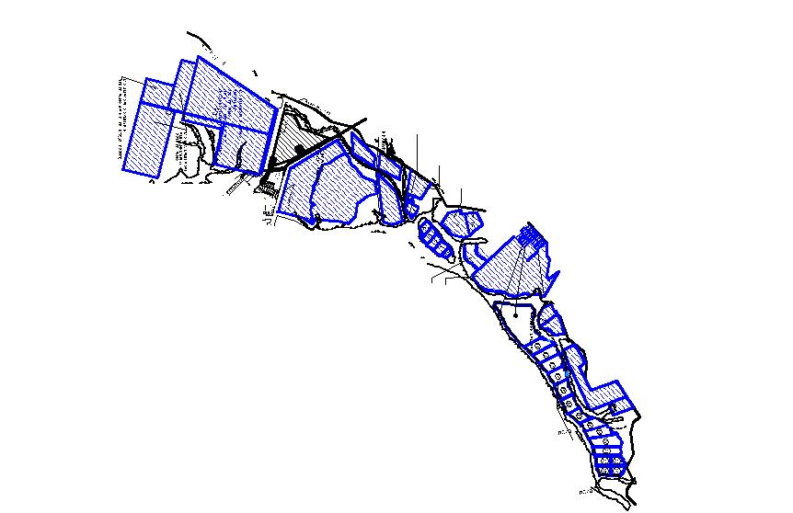
SALT PLOTS
Plots under E-auction = 46 Nos.
Timeline = March 2019
Total Revenue = Rs. 16.37 Cr Per Annum
BACK

Slide 89
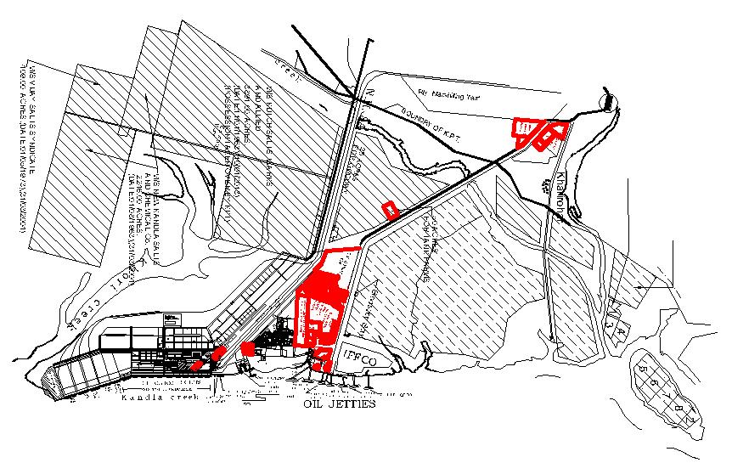
LIQUID TANK FARM PLOTS
Plots under auction = 4+7 Nos.
Timeline for Auction = March 2019
Total Revenue = Rs. 28.15 Cr. Per Annum
BACK

Slide 90
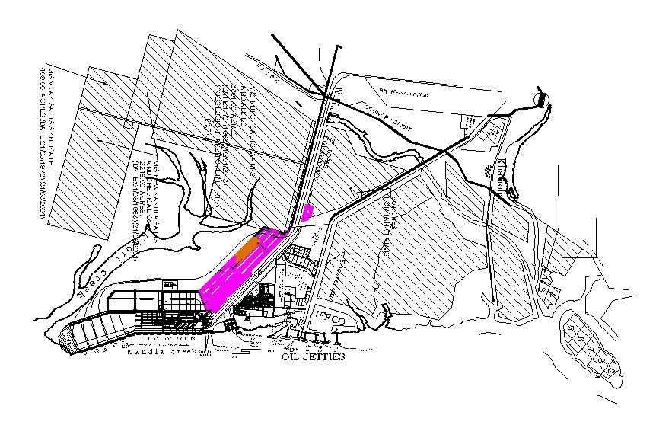
GODOWN & PORT RELATED ACTIVITY PLOTS
Plots under auction = 7 Nos.
Timeline = March 2019
Total Revenue = Rs. 3.08 Cr. Per Annum
Revenue for other misc. plots = Rs.7.52 Cr. Per Annum
BACK

Slide 91
ACTION TAKEN REPORT ON THE MINUTES OF MID YEAR REVIEW MEETING HELD ON 6th-7th NOVEMBER, 2017 AT GOA
Sl. | Activity/ Decision | Timeline | Updated Status on the Action Taken by DPT
1 | To undertake comprehensive measures to improve operating margin DPT | Feb,2018 | As against the estimate of Rs.692.28 cr, the actual total operating expenditure for the year 2017-18 is Rs.677.99 cr. Further, as against the actual dredging expenditure amounting to Rs.133.34 cr in 2016-17, actual dredging expenditure in 2017-18 is Rs.108.22 cr. Further, during the year 2017-18, a reduction of Rs.2.17 cr has been achieved in power cost mainly due to rebate on power bills on account of wind power projects.
2 | DPT to collaborate with llT Madras for continuous monitoring for long and short-term dredging cost reduction. | Nov,2017 | IIT Madras appointed for consulting services and study in progress.
3 | DPT was advised to avoid delay in pipeline Permission post Tank-farm plot auction. | Immediate | Noted and pipeline permission granted for auction of tank farm plots.
.

Slide 92
ACTION TAKEN REPORT ON THE MINUTES OF MID YEAR REVIEW MEETING HELD ON 6th-7th NOVEMBER, 2017 AT GOA
Sl. | Activity/ Decision | Timeline | Updated Status on the Action Taken by DPT
4 | DPT was advised to complete the auction of remaining salt lands at the earliest | Dec-17 | The On-Line Technical Bids for 46 Nos. of salt land have been opened on 05-03-2018 and 06-03-2018. Price bid will be opened by August,2018.
5 | DPT's lackadaisical approach towards Mechanization and pipeline rationalization was noted. DPT was directed to undertake mechanization of CJ16 / CJ t4 handling of fertilizers & dry bulk. After deliberations the Port was advised to take up the project in EPC mode, to have a level-playing field for users. |  | Rationalization of pipelines:- DPT appointed M/s MECON Ltd. who have prepared the EPC Contract and are also undertaking EIA studies. NIT will be issued in Aug-2018. Mechanization of fertilizer handling at berth No.14: The SFC has approved the project as communicated vide MoS letter dated 5.6.2018. The bidding documents are under approval. Project is scheduled to be awarded by Oct’18 and to be completed by Oct’20.
6 | DPT was advised to reduce the timeline for the projects to be awarded to ensure faster execution | Immediate | Three Nos. of projects awarded during FY 2017-18

Slide 93
ACTION TAKEN REPORT ON THE MINUTES OF MID YEAR REVIEW MEETING HELD ON 6th-7th NOVEMBER, 2017 AT GOA
Sl. | Activity/ Decision | Timeline | Updated Status on the Action Taken by DPT
7 | DPT was advised to extend facilities and incentives to boost Ro-Ro shipping through the port. | Feb-18 | M/s. SICAL was operating the RoRo coastal services and all necessary arrangements were made to facilitate coastal RoRo movement. However, despite grant of rebate upto 90%, no RoRo vessel has called at Kandla after April, 2017. M/s. Ford have been requested to have an interaction with the concerned stakeholders.
8 | Ministry officials to follow up and expedite the environment clearance for OJ7 and 2 SBMs proposed in Vadinar | Nov-17 | Environmental clearance is not issued due to NGT Order.
10 | DPT to undertake study to promote exports to Afghanistan, CIS countries, through Chahbahar Port. | Mar-18 | A study to promote exports to Afghanistan, CIS countries, through Chahbahar Port has been entrusted to M/s. Mckinsey and the report is awaited Till date, 25 container vessels carried 30726 TEUs to Chabahar 20448 TEUs in 2016-17 10278 TEUs in 2018-19 (upto 26th June, 2018)
11. | DPT to identify jetty for LPG terminal. | Dec-17 | No. 7 Oil Jetty has been selected by M/s.IOCL for handling LPG as per their expansion plan under PMUY scheme for handling LPG upto 5 MMTPA by the year 2025. Work was awarded on 26-10-2015. Environment Clearance (NGT Issue) awaited.

Slide 94
ACTION TAKEN REPORT ON THE MINUTES OF MID YEAR REVIEW MEETING HELD ON 6th-7th NOVEMBER, 2017 AT GOA
Sl. | Activity/ Decision | Timeline | Updated Status on the Action Taken by DPT
12. | DPT to identify new jetties for development of Liquid and bunkering terminal. | Jan-18 | Four oil Jetties ( OJ 8,9,10& 11) are identified for handling liquid cargo .
13. | DPT to pursue growth of Vadinar Crude Oil Traffic through augmentation of Mathura – Salaya Pipeline. DPT may pursue with IOCL in developing the pipeline with Port funds | Dec-17 | Letter to the Secretary, Shipping, sent by the Chairman, DPT, requesting to take up the matter with the Ministry of Petroleum & Natural Gas for augmentation of the pipeline from Vadinar to Mathura so that the optimum use could be made of the capacity of SPM upto 50 MMTPA from 25 MMTPA at present.
14. | DPT to fund IPRCL's DPR preparation for Kandla - Jaisalmer line | immediate | Yes, DPT is funding to IPRCL for DPR preparation of Kandla Jaisalmer line.
15. | DPT to expedite the commissioning of all units in the bagging/rake loading Plant | Dec-17 | All the 20 units have been erected. Testing and trials completed. Will be commissioned by July 2018.

Slide 95
All PORTS/ GENERAL ADVISORY
Sl. | Activity/ Decision | Timeline | Updated Status on the Action Taken by DPT
139 | All ports to send list of pending issues with MoPNG, Ministry of Coal, Ministry of Railways and other Ministries /Organizations to JS(p) and the same shall be discussed in the weekly SOM at Ministry and followed up regularly. | Nov-17 | The list of pending issues with Various Ministries has been sent to the MoS.
145 | IIT Madras to comprehensively study the maintenance dredging requirements in all ports and suggest measures to reduce the same, all ports to collaborate with IIT Madras for Continuous monitoring for long and short-term dredging cost reduction. The proposal to Establish a Centre of Excellence at IIT Madras to be expedited. | Dec-17 | DPT contributed its share for the year 2017-18 = Rs. 19.03 Lakhs. DPT has released the payment to NTCPWC on 15.05.2018.
156 | All Ports to explore possibility of safely reducing the under-keel clearance in stages to harness higher draft (using latest technologies) | Immediate | Prof. K. Murali of IIT carried out mathematical model tests of Kandla Sogal Channel and recommended that container vessels of maximum LOA of 340mtr can be handled at Kandla. Also container vessels of LOA 330mtr can be handled with a draft of 14.0mtr when height of tide is 6.40mtr or above.
.

Slide 96
All PORTS/ GENERAL ADVISORY
Sl. | Activity/ Decision | Timeline | Updated Status on the Action Taken by DPT
157 | All Ports to expedite the construction of the Sewage Treatment Plant (STP), as required, for the management of organic waste. | Dec-17 | DPT is already having STP plant at Gopalpuri. Consultant suggested to enhance the capacity.
158 | All ports to send a list of stalled projects to Ministry. Ministry to consider the issue of stalled projects and take appropriate measures | Dec-17 | The list of stalled projects has been sent to the Ministry.
161 | All ports to examine the proposal of extending joint discounts/concessions (for viable load- discharge/transhipment/ lighterage OD pairs) to the trade in order to pursue traffic / revenue growth and higher capacity utilization. | Mar-18 | DPT will take-up joint discussion for discounts/concessions (for viable load- discharge/transhipment/lighterage OD pairs) to the trade on coastal RoRo, coastal container transhipment, Fertilizer and Salt.

Slide 97
RETIREMENT PROFILE
Year | No. of employees/workers
2018 | 118
2019 | 175
2020 | 156
2021 | 142
2022 | 136
2023 | 115
2024 | 128
2025 | 127
Total | 1097
BACK

Slide 98
MAJOR COMMODITIES HANDLED AT DEENDAYAL PORT
(A) I M P O R T S
In Lakh Tonnes
Commodities | 2016-17 | 2017-18
Crude Oil at Vadinar | 441.28 | 448.05
POL Products | 19.43 | 21.37
Phosphoric Acid & Ammonia | 21.23 | 17.21
Edible Oils | 45.38 | 49.70
Other liquids | 28.39 | 29.44
Finished Fertilizers | 33.50 | 35.62
Fertilizer Raw Material | 3.06 | 1.42
Iron & Steel | 10.70 | 11.48
Timber Logs | 26.77 | 28
Containerized Cargo | 0.24 | 3.2
Other Dry Cargo | 182.24 | 165.92
TOTAL IMPORTS A | 812.22 | 811.41
BACK

Slide 99
MAJOR COMMODITIES HANDLED AT DEENDAYAL PORT
(B) E X P O R T S
In Lakh Tonnes
Commodities | 2016-17 | 2017-18
Liquid Cargoes: castor oil, Chemicals and POL | 16.05 | 26.58
Food Grains | 3.91 | 3.94
Ores | 3.43 | 2.13
Salt | 62.75 | 74.74
Oil Extractions | 9.07 | 12.02
Containerized Cargo | 1.51 | 15.18
Other Dry | 16.74 | 25.95
Exports at Vadinar | 125.05 | 123.52
TOTAL EXPORTS (B) | 238.51 | 284.06
TRANSHIPMENT (C) | 3.69 | 5.52
OVERALL (A + B + C) | 1054.42 | 1100.99
BACK
DEENDAYAL PORT TRUST

Slide 100
FINANCIAL PERFORMANCE
 | 2016-17 | 2017-18
Traffic Handled (MMT) | 105.44 | 110.09
Operating Income (Rs. in Crore) | 1383.15 | 1475.35
Operating Expenses (Rs. in Crore) | 658.79 | 677.99
Operating Surplus (Rs. in Crore) | 724.36 | 797.36
Operating Margin (%) | 52.37 | 54.05
Net Surplus (Rs. in Crore) | 693.86 | 546.45
Net Margin (%) | 44.14 | 31.47
Cost per Ton (Rs.) | 62.48 | 61.58
BACK
DEENDAYAL PORT TRUST
Notes:
100

Slide 101
ROAD AND RAILWAY NETWORK
Broad Gauge Railway Connectivity
Railway Siding Near Godowns.
23 km Railway Network inside cargo jetty area
Four Lane National Highway No. 141, extended right up to the port’s main gates
30 km Roads inside the cargo jetty area
31 km Roads outside the cargo jetty area
Simultaneous 7 Full Rake Loading capacity inside the port
Around 12 MMT Rail borne cargo is handled from/for Deendayal Port and Rail Co-efficient of Dry Cargo is about 30%.
Construction of Berth No. 13 to 16 and its Rail Connectivity is expected to complete by Sep-2019.
Berth No. 13 to 16 is going to add about 20 MMT Dry Cargo with Railway Share of about 6 to 8 MMT.
New Rail Connectivity for Railway Line No. 13, 14 & 15 shall provide fast evacuation of Fertilizers from the Port and has capacity to handle 4 trains in a day(around 3.5MMT per year).
BACK
Notes:
101

Slide 102
Infrastructure Facilities - Dry Cargo
Sr. No | Facility | Kandla’s Edge
1 | Dry cargo berths (1 to 10 Berths) (20.62 MMTPA) Container Terminal (11 & 12) (7.20 MMTPA) BOT Berths (13 & 15) (9 MMTPA) | Straight Line berths flexible to accommodate different sizes and length of vessels
2 | Multi Purpose Berths | Capable of handling all kind of dry cargoes
3 | Draft up to 13 meters
4 | Barge handling facilities: Bunder Area and Tuna Port (5.11 MMTPA) 7 Floating Cranes capacity of 1 MMT each | Facilitate to handle Cape size vessels
5 | 12 ELL wharf cranes ranging from 8 to 25 MT capacity and two MHCs of 63 MT capacity | Capable of handling wide variety of dry cargo
6 | 4 Nos. MHCs presently working | Capacity 1.50 MMT each
7 | Custom bonded area | 35.00 lakh sq. meters
8 | Open Storage area | 18.95 lakh sq. meters
9 | Covered Storage area | 2.03 lakh sq. meters
BACK

Slide 103
Dry Cargo Handling Equipment
Sr. No | Cargo handling Equipments provided by Private Operators
1 | 4 Nos. Mobile Harbour Cranes
2 | 7 Floating Cranes for stream handling of cargo to overcome draft restrictions.
3 | Crawler Mounted Cranes
4 | Timber Grabs
5 | Bulk Grabs
6 | Pay Loaders
7 | Reach Stackers
8 | Top Lift Trucks
BACK

Slide 104
Infrastructure Facilities - Liquid Cargo
Sr. No | Facility | Kandla’s Edge
1 | 6 Liquid Jetties | 13.00 million metric tonnes capacity
2 | Liquid storage tanks | Around 23 lakh KL storage capacity
3 | 3 SPMs & 2 product jetties at Vadinar. | Pioneers in SPMs in the country.
4 | Capacity to handle crude at Vadinar | 38.68 million metric tonnes
5 | 30 meters Draft at Vadinar | VLCC- 3 lakh tonnes vessels handled
BACK

